Slide 1

Thoughtful Generosity
Presentation to Gambling Sector Forums
Tony Paine, CE Philanthropy NZ
March 2017

Slide 2

Philanthropy & Grantmaking
3 Conversations
Philanthropy NZ

Slide 3
Community sector sustainability:
Funding burden
Grantmaking pyramid
Venture philanthropy

Slide 4
Funding Burden | Single organisation
Value of grant | $5000
Cost to apply (time, staff) | $1000
Real value of grant | $4000
Funding Burden | Community
Value of fund | $80,000
Number of applicants | 100
Cost to apply/applicant | $1000
Cost to community | $100,000
Impact of fund on community | - $20,000

Slide 5
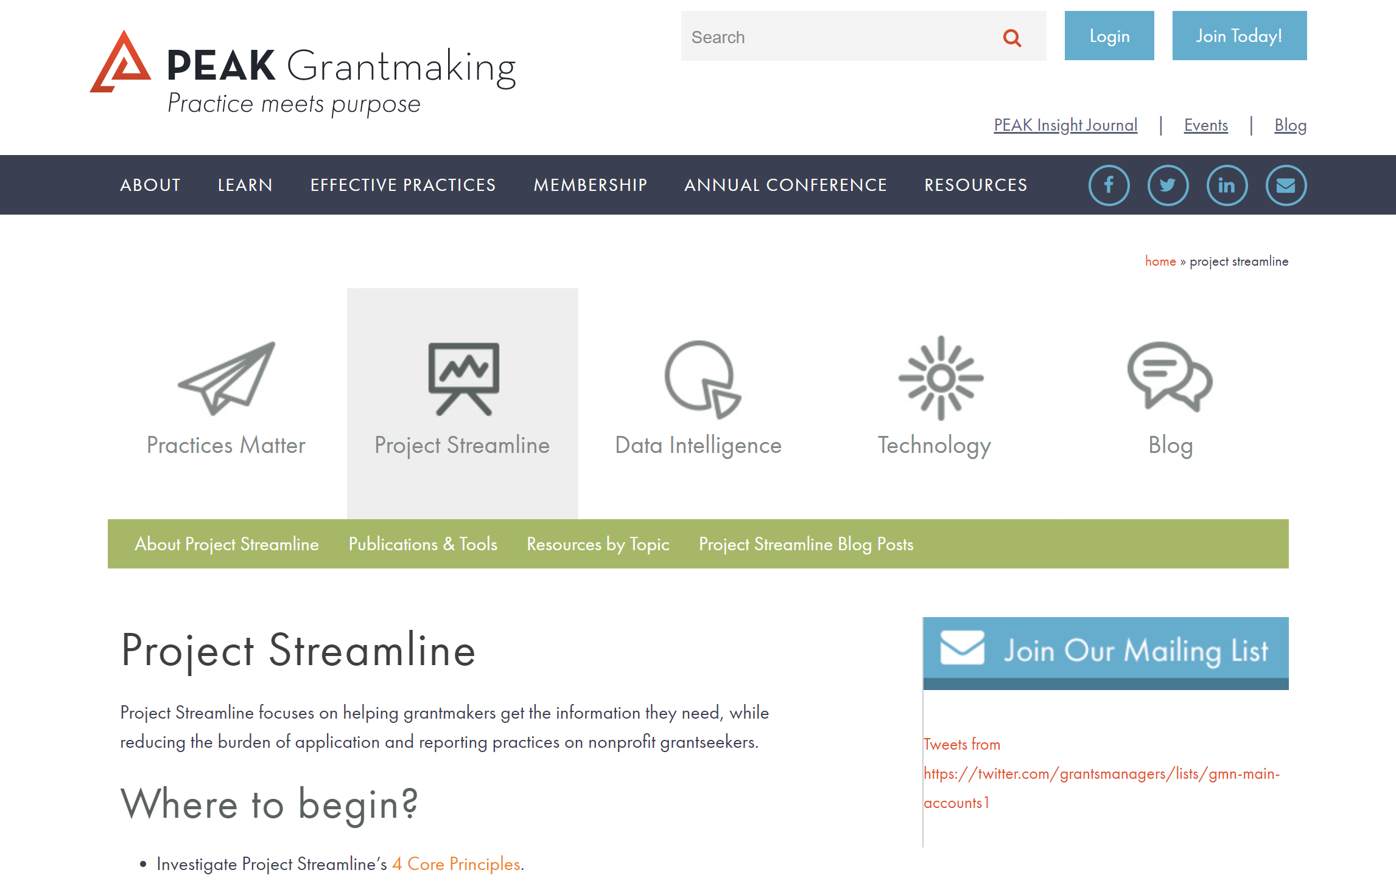

Slide 6
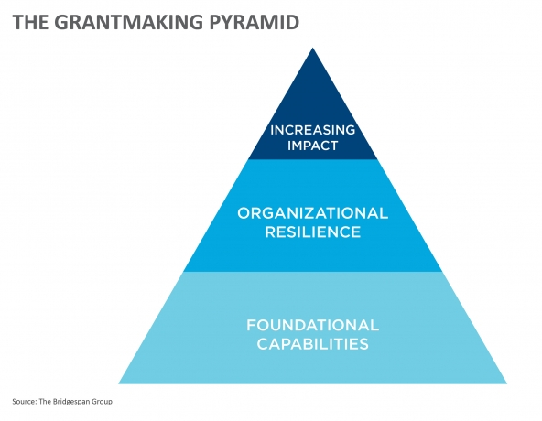

Slide 7
Relationship with community:
Transparency & participation
Diversity
Who are we not reaching?

Slide 8
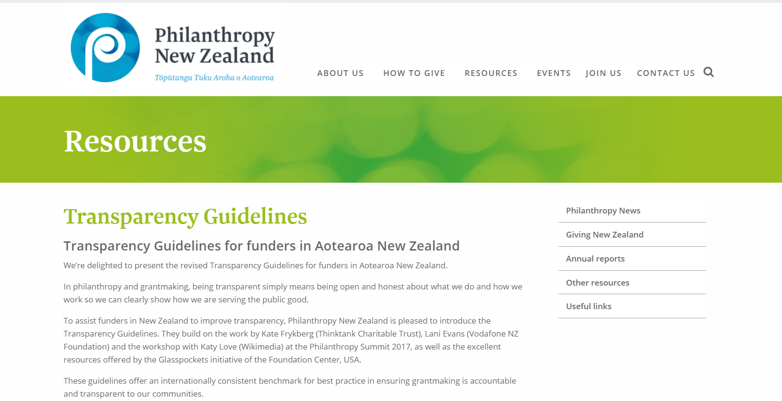

Slide 9
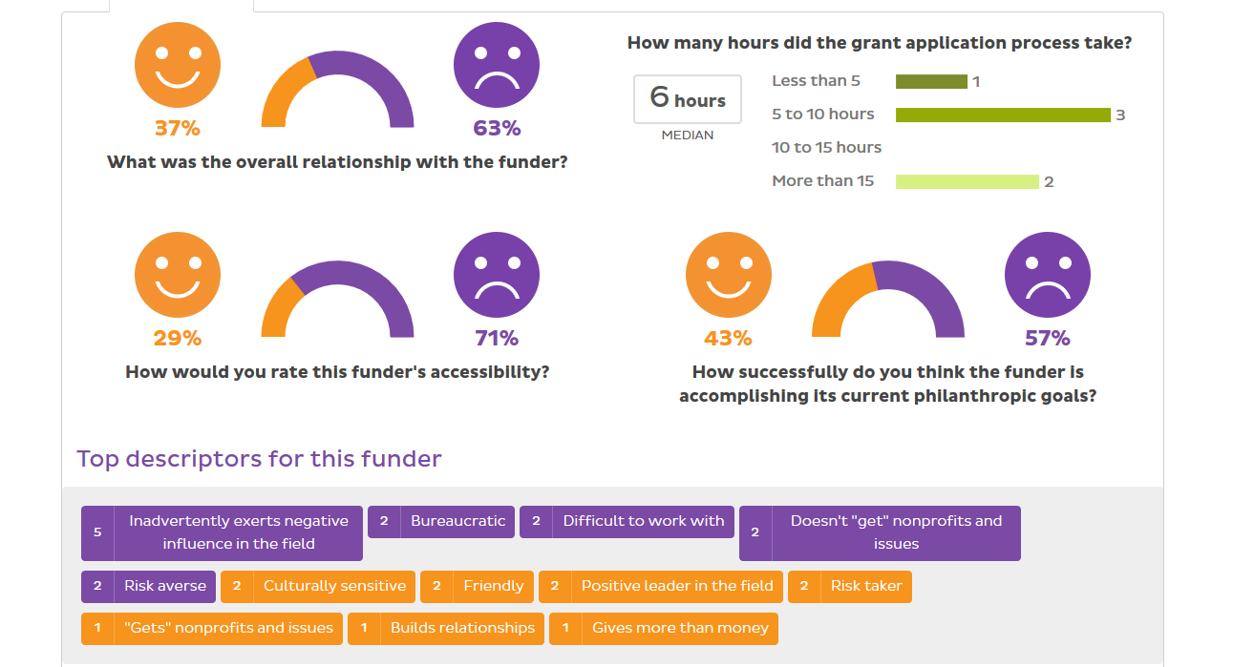

Slide 10
Change & Impact:
‘Wicked’ problems
Impact Investing & Social Enterprise
How do we know we’re making a difference?

Slide 11
Philanthropy New Zealand
Networks & Events
Summit
Professional development
Connections
Advocacy & Government
Best Practice
Support others on their journey

Slide 12
Thoughtful generosity:

Slide 13
Links:
PNZ Transparency Guidelines
Project Streamline
Bay Brighter Futures
Peter McKenzie Project
NEXT Foundation Tomorrow Accord
JR McKenzie report on philanthropic funding to Maori
NZ Impact Investing Network
Participatory Philanthropy
Centre for Social Impact
Vodafone Youth Strategy

