Slide 1
The Gamble
Host Project –
Where to Next

Slide 2
Overview
1. The roll-out of the Gamble Host Resources
2. Developing an introductory module
3. Ethnic specific resources
4. How should we measure and celebrate success?

Slide 3
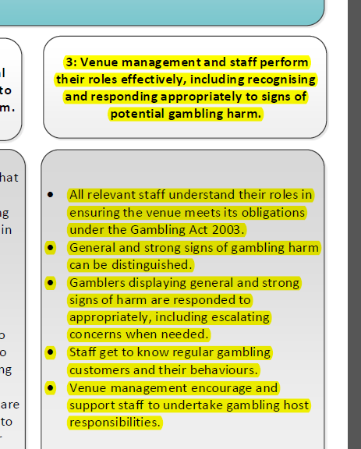
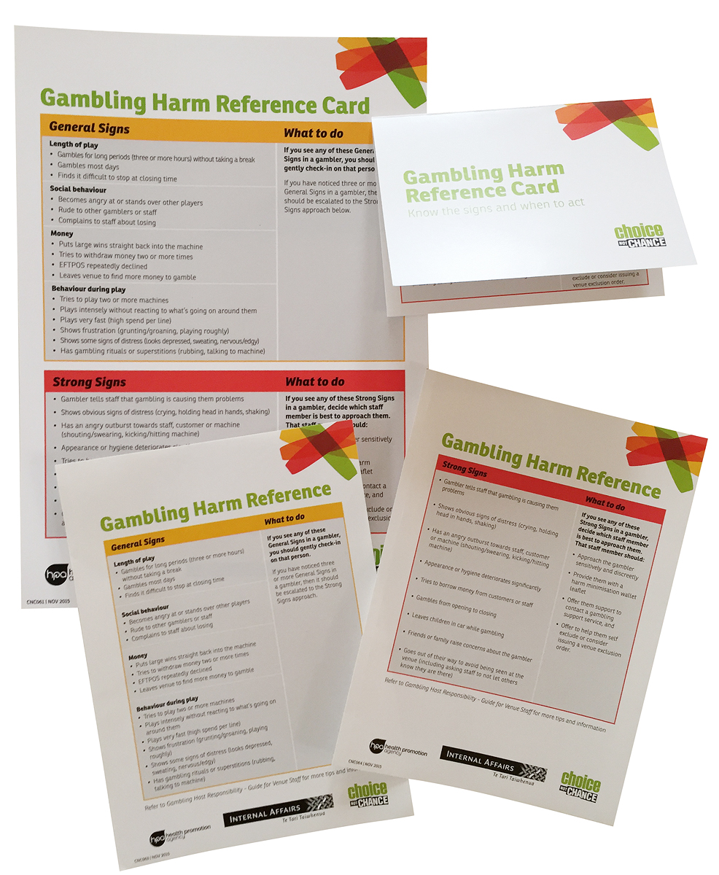
Gamble Host Roll-out

Slide 4
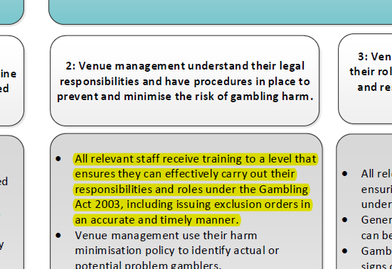
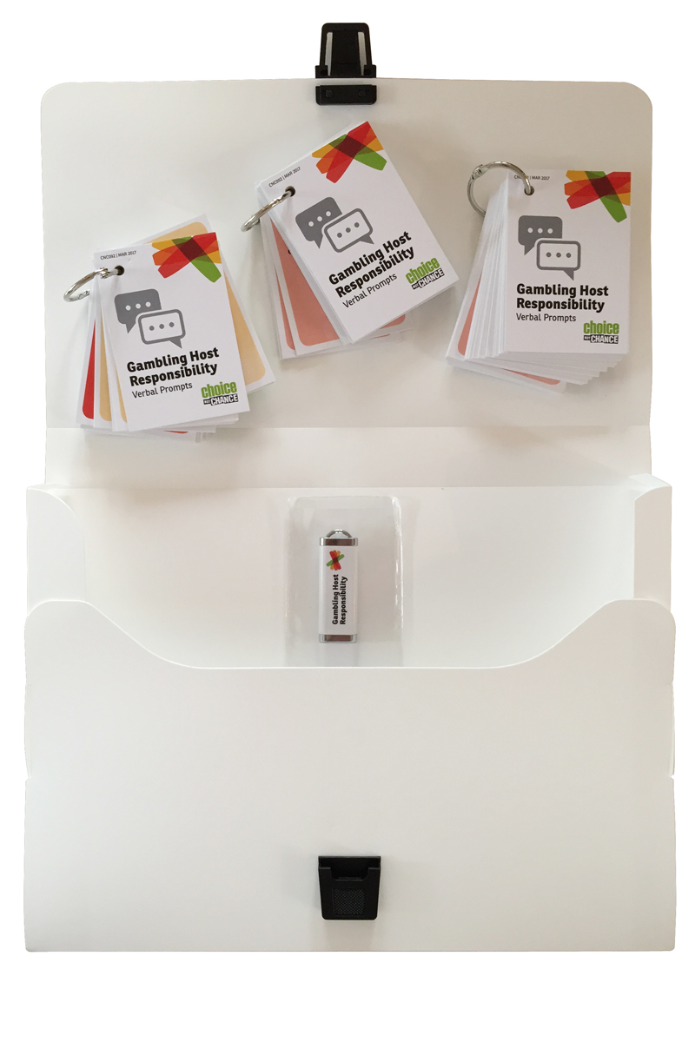
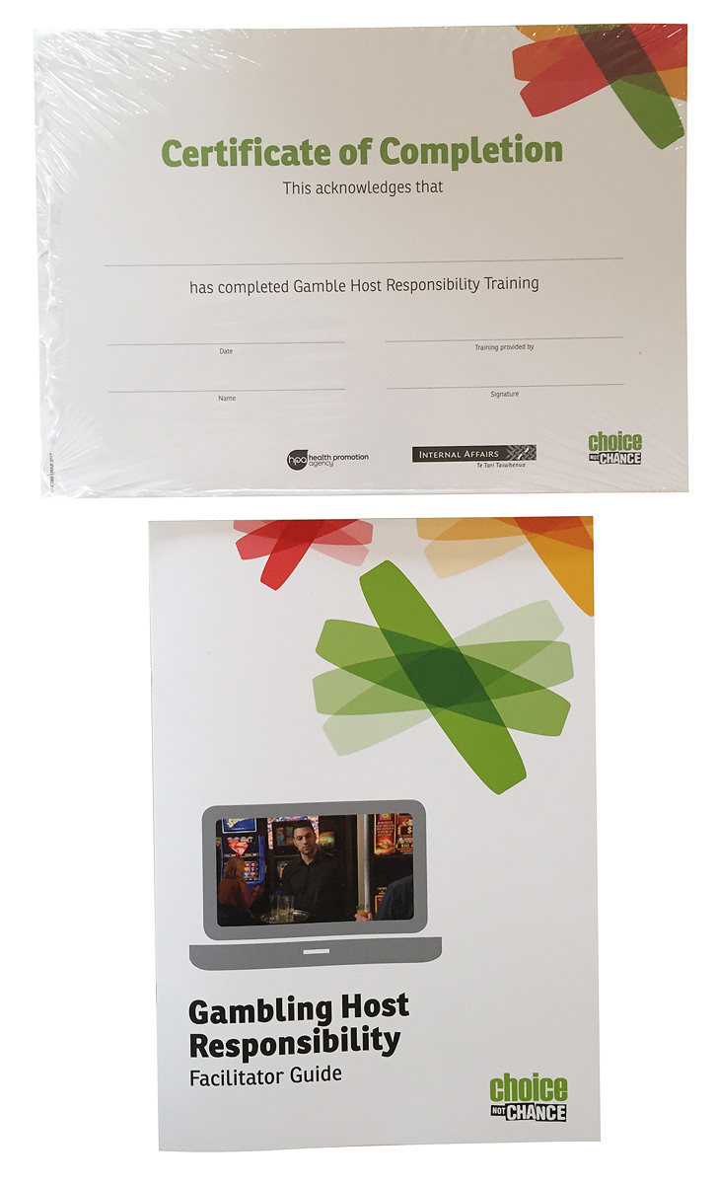
Gamble Host Roll-out

Slide 5
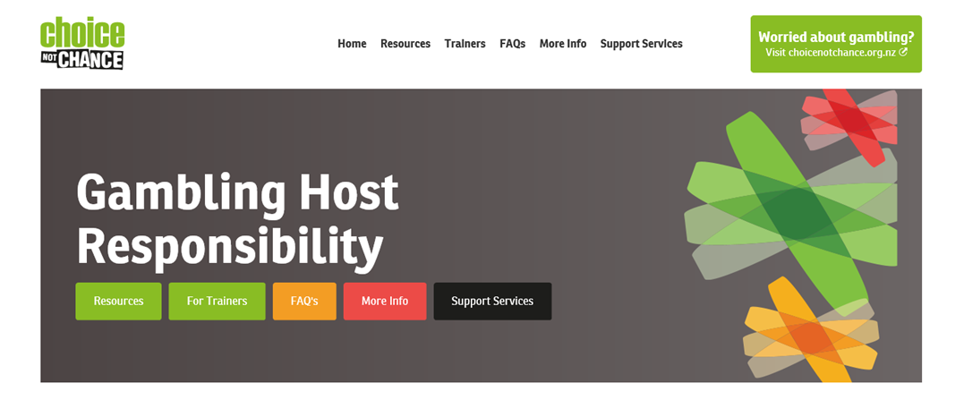
Gamble Host Website - https://gamblehostpack.choicenotchance.org.nz/

Slide 6
What should be included in an introductory module?
Introduction to Gambling Host Responsibility
Why is gambling host responsibility important?
What are your obligations?
What should you be doing on a daily basis?
What are the signs you should look for?
How should you respond?

Slide 7
Ethnic specific resources
Strong interest in resources specifically for Maori, Pacific and Asian
Recent research project with Maori and Pacific gamblers
Refresh of posters and new resources

Slide 8
How can we measure improvements and celebrate success?
Current range of activities:
  National Survey – reports on interaction between staff and gamblers and what messages patrons see in venues
  Venue inspections and Mystery Shopper/Kaihoko Muna
  Gambling Helpline and Services data
Gamble Host Awards
  What improvements are you seeing?
  What other ways could we monitor improvements and celebrate success?

Slide 9
Any Questions?

