Slide 1




Welcome to the
Gambling Forums

Slide 2

Notes:
We are committed to working together to achieve our vision of regulating for a safe, transparent and trusted gambling sector that benefits communities.

Slide 3

Working collaboratively
Kaihoko Muna/Mystery shopper co-design
Gamble Host resources
3 Year Licences
Venue Assessments
….to name a few

Slide 4

What’s on the horizon?
Notes:
Horizons review
Systems leadership
Technology
Continued focus on culture of care
Grant funding

Slide 5
Culture eats strategy for breakfast.

Slide 7


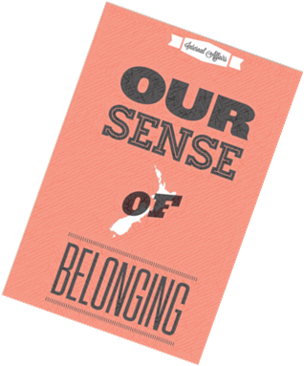

The NZ Gambling Framework
BENEFITS
Licensing system
Grants
Social Capital
Entertainment
Strong Communities
Gambling harm
Game integrity
Fairness / fraud
TRUSTED & TRANSPARENT
CONSUMER
PROTECTION

Slide 8

… we are not just a sheriff!
Notes:
We are not just the sheriff!
We want to engage and help people comply while we regulate the sector.

Slide 9
Braithwaite Triangle
Attitudes
Our response
Decide not to comply
Use the full force of the law
Do not want to comply
Deter by detection and administration action
Try to comply but do not always succeed
Support to comply
Are willing to do the right thing
Make it straight forward to comply

Slide 10
Changing our culture…
“We make them comply”
Everyone works to continually improve
gambling practice
Highlight failings
Influencing behaviour /solution focus
Information gathered used to ensure
compliance
Information gathered is shared with
sector, and informs where to next
Broader range of activity to balance
outcomes of market sustainability,
harms, community benefit, sector
integrity, and enjoyment
Outputs (license, inspect, audit,
investigate, enforcement action)
Reactive
Proactive, target by risk
Mutually driven, proactive engagement
Regulator driven engagement
Understand operator’s environment and
capability

Slide 11

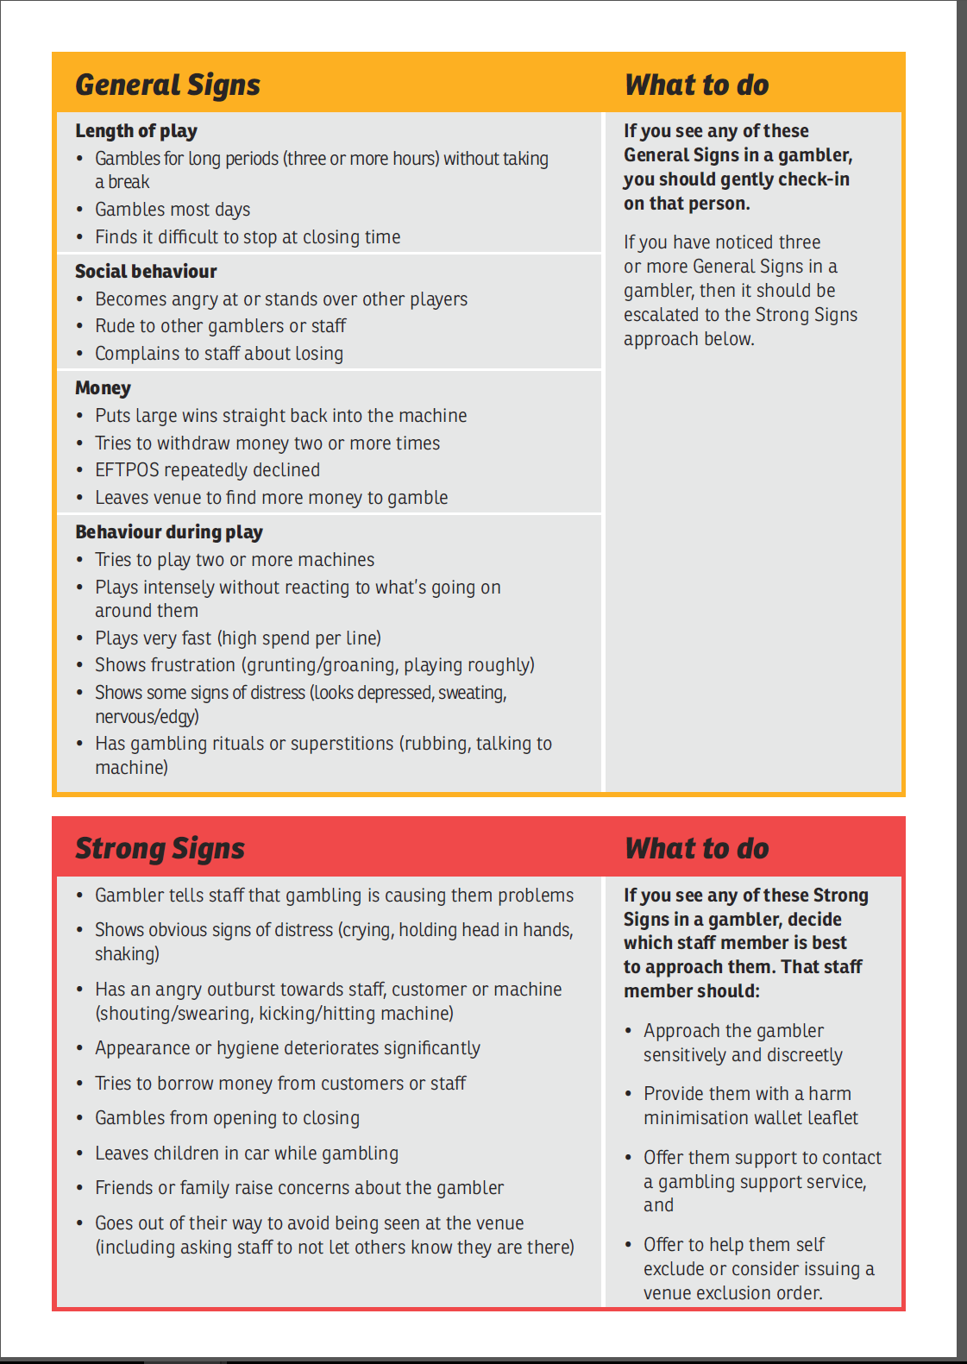
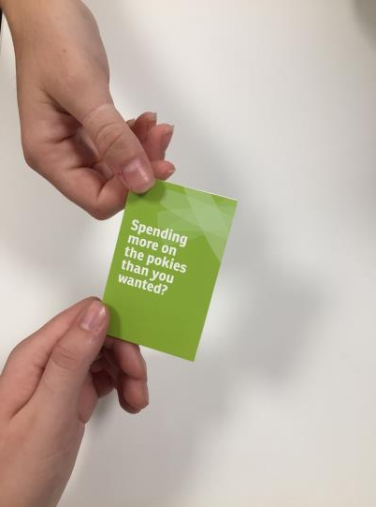
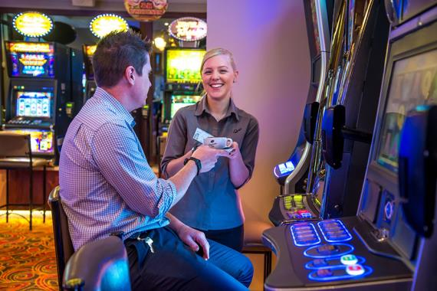

Department Expectations
Notes:
The sector should
Meet legal requirements
Make sure staff interacts with gamblers
Make sure staff know the general and strong signs of problem gambling
Make sure staff note down observations of problem gambling behaviour
Make sure staff know how to respond appropriately to different signs of harm

Slide 12

Culture of Care

Slide 13
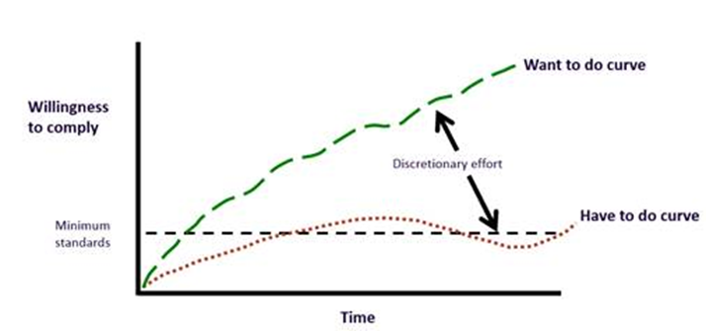
Good Practice

Slide 14
Harm Minimisation
Framework
Creating a culture of care
Tools
Education
Training
Resources
Venue assessments
Mystery shopper
ENGAGEMENT
Licensing
Outcome

Slide 15

Some Outcomes So Far…
Notes:
66% of pokie trusts agree their venues are better supported to minimise gambling harm [DIA May 2015 sector forum survey]
86% of pokie trusts found the materials useful [DIA May 2015 sector forum survey]
+20% percentage increase of gamblers who had interaction with venue staff between 2014 and 2016 [Health and Lifestyles survey]

Slide 16


Slide 17


Principles in action
Based on Māori values
Whanaungatanga – a relationship through shared experiences and working together, which provides people with a sense of belonging
Manaakitanga – Hospitality, kindness, generosity, support, the process of showing respect and care for others
Kotahitanga – unity, togetherness, solidarity and collective action
He Tangata - its about the people

Slide 18

Questions

