Slide 1


Kaihoko muna
Mystery shopper
Regional Workshops 2018

Slide 2
Mystery Shopper 2016
Random selection of 120 pubs and clubs
Provided a snapshot of how well staff identified and responded to signs of gambling harm
Highlights opportunities where further support can be provided

Slide 3
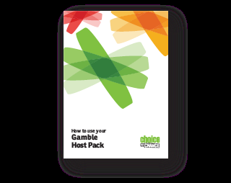
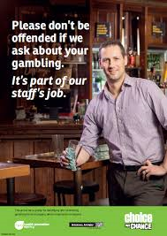
Notes:
Four scenarios were developed that tested both general and strong signs. Given that we had worked closely with the sector on the Gamble Host resources, the expectations outlined in these resources formed the basis of the scenarios. In particular we wanted to test identification of strong and general signs of behaviour that indicates potential gambling harm and whether venues were fulfilling their gambling host responsibilities.
Scenario 1: Tested a collection of general signs over three days and was designed to give venue staff an opportunity to pick up on harm cues.
This scenario was a general sign from someone who gambles most days. Each visit in isolation displayed general signs, however cumulatively this scenario displays strong gambling harm signs and gives operators the chance to observe and monitor patron play over three consecutive days for a total of four hours each day.
Scenario 2: Focussed on access to money and saw the customer making multiple cash withdrawals, having repeated EFTPOS declines, and leaving the venue to borrow money.
Scenario 3: Focussed on long hours of play, with someone who found it difficult to leave the venue and indicated to staff that they should be elsewhere.
Scenario 4: Tested a venues response to third party concerns. This was tested by a mystery shopper speaking to staff about their concerns for a gambler, providing a photograph, and the gambler concerned attending the venue after.

Slide 4
Beyond the exercise
“The results clearly demonstrate that there are still shortcomings in the ‘Harm Prevention’ loop and all stakeholders have a duty of care to now collectively & constructively work together to improve industry standards moving forward.”
- Society response to MS results

Slide 5

Kaihoko muna / Mystery shopper
Minimise gambling harm by adding kaihoko muna/mystery shopping to our toolkit to:
    identify poor performance
    collect data
    promote best practices

Slide 6



Co-design of scenarios

Slide 7


