Slide 1



Exclusions

Slide 2
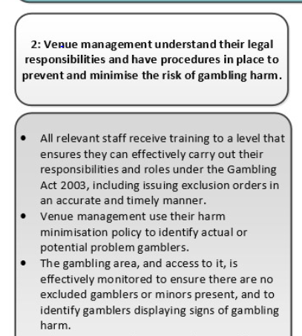
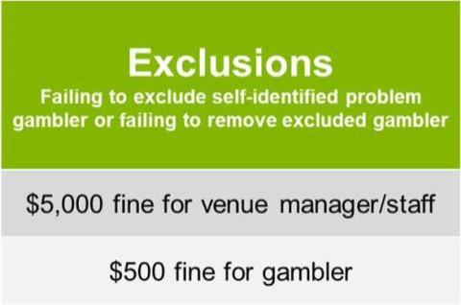
Exclusions
  Are one part of a number of measures to prevent and minimise harm
  Are a practical way to manage harmful gambling behaviour
  Can be issued for up to two years and can never be revoked or renegotiated

Slide 3
What types of exclusions are there?
Self Exclusion (310)
Gambler can request an exclusion by writing, in person or through a Counsellor.
Staff might suggest that a gambler they are concerned about adopts a self exclusion.
Venue Initiated Exclusion (309/A)
If the gambler does not opt for a self exclusion and concerns remain, then a staff member can issue a venue initiated exclusion.
Multi-Venue Exclusion
Gamblers can choose to exclude themselves from a number of venues in the region.

Slide 4

Who’s involved in exclusions?
Exclusions
Societies
Government agencies
Venues / staff
Treatment service providers / MVE coordinator
Customer / gambler

Slide 5
What steps need to be taken with exclusion?
1
You (or another staff member) must issue an exclusion order promptly.
Agree on the length of the exclusion period (recommend between 6 months to 2 years).
2
Provide information on how the person may exclude themselves from more than one venue
(Multi-Venue Exclusion).
3
Offer to put them in contact with a counsellor.
4
If it is a self-exclusion, ensure you have the person’s name, birthdate and a photo. If it is a venue-initiated exclusion, ensure you have enough information to reasonably identify the person.
5
Fill out the paper work and follow the processes associated with exclusion orders in your venue.
6
Once the exclusion order is complete, follow your venue’s process for record-keeping and tracking exclusions. This includes knowing what to do if you see an excluded person in the gambling area of your venue.
7

Slide 6
What should you do when you get an MVE?
1
Issue a self-exclusion order as per your normal process
2
Return the client’s copy of the Self Exclusion Order to the MVE Coordinator
3
Monitor your venue/gaming room to ensure excluded persons do not enter gaming area
4
Contact your MVE Coordinator if you are worried about a patron or an excluded person trying to gamble in your venue

Slide 7
Issues identified from MVE review
Difficulty managing number of exclusions
Consistency of process
Administration process
Greater clarity of roles and responsibilities
Electronic centralised system

