Slide 1
Jobs for Nature
DIA Presentation
DOC-6377618
Notes:
DIA presentation
Audience - subgroup of local govt, some new to this context
Present current context
Ask them questions
Outcome: The have sufficient clarity about the work so they can describe it and enthuse about it.
They need to be able to explain it to others - their teams/colleagues

Slide 2
Jobs for Nature - ($1.3bn)
Jobs for Nature is a $1.3 billion programme of broad environmental funding. It is part of the COVID-19 recovery package. The programme is intended to run for four years.
Jobs for Nature aims to:
Provide up to 11,000 jobs and economic support for people and communities across Aotearoa, while ensuring environmental beneﬁts.
Get money and support as quickly as possible to people and communities to assist the COVID-19 recovery.
It is a cross agency programme including MfE, DOC, MPI, LINZ, PDU, and One Billion Trees/Te Uru Rakau (TUR).

Slide 3
DOC Jobs for Nature: $500m breakdown
Restoring Nature ($154.3m)
Protecting Nature ($147.5 m)
Kaimahi for Nature ($200m)
Ecosystem restoration on public and private land. DOC will work with the Queen Elizabeth II National Trust, NZ Landcare Trust, regional councils, Treaty partners and landholder groups to create jobs
Jobs in pest control and eradication, including advancing Predator Free New Zealand and working with iwi to prevent the collapse of North Island forests
Targeted towards helping businesses maintain their workforce and do nature-based work as they move towards economic recovery
^{Delivered through}
^{Alliances}

Slide 4
DOC Jobs for Nature: Beneﬁts
Conservation legacy, including:
Large areas free of wilding pines Freshwater gains
Wallabie control
Supercharge predator free
Protect investment on private land (Covenants) Kiwi – meet the 2% recovery goal
Social outcomes
Deliver meaningful jobs
Avoid the long tail impact of recession
Step change in the way we work
Changed relationship with Treaty partner – power shift, Treaty partner and Crown working with regional government
Partnerships are at the heart of Jobs for Nature. This is about working with Treaty Partners, communities, businesses, local government, and government agencies to best support people through nature-based employment.
New way of working with regions – decision-making at place

Slide 5
Kaimahi for Nature is…
$200 million fund focused on working with businesses who are looking to avoid making staﬀ redundant.
Kaimahi for Nature aims to reach workers before they become unemployed – giving businesses battling COVID-19 an opportunity to temporarily redeploy their staﬀ into environmental projects in their own region.
Key outcomes from Kaimahi for Nature
Faster recovery for individual businesses
People retain a strong sense of purpose and pride from restoring their place
Faster regional recovery
National gains in conservation and the environment
Avoid people becoming unemployed
Kaimahi for Nature is delivered through Alliances
Alliances are...
Treaty Partners, Regional Councils and DOC in regions.
Alliances hold the knowledge, relationships, and tools in regions to deliver Kaimahi for Nature at scale.
A number of Alliances exist around Aotearoa, while others will need support to be set up.
Alliance Guiding Principles
Maximise regional decision making
Treaty partners and working in partnerships are central to the programme
Get funds out fast
Equitable distributions of funds across NZ
Minimise duplication
National, iwi, and regional environ-mental priorities set direction

Slide 6
The role of Alliances
Get set up
Identify and prioritise projects
Help match workers to projects
Monitor and fund projects
The purpose and role of Alliances can go beyond Kaimahi for Nature - partnerships are just the way we work to achieve enduring environmental outcomes. Alliances will be ‘connecting the dots’ between various projects and funding initiatives within Jobs for Nature, ensuring strong, integrated outcomes now and in the future.

Slide 7
Current Mahi
Completing System design
Developing key support documentation
Testing with a live Alliance
Ministerial approvals
Alliance initiation in every region

Slide 8
Kotahitanga mō te Taiao
Kotahitanga mō te Taiao is an Alliance consisting of all councils, most of the iwi in the top of the South Island, and DOC, covering the Buller to Kaikoura region
Kotahitanga mō te Taiao is currently testing Kaimahi for Nature
Notes:
Questions
What issues or opportunities come to mind about how Alliances might work in your region?
How engaged are you now with mana whenua?
How might your local treaty partnerships work in an Alliance?

Slide 9
Handouts

Slide 10
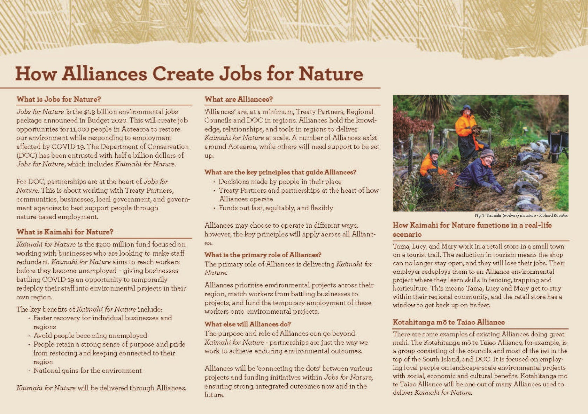
Handout 1 – page 1
How Alliances Create Jobs for Nature

Slide 11
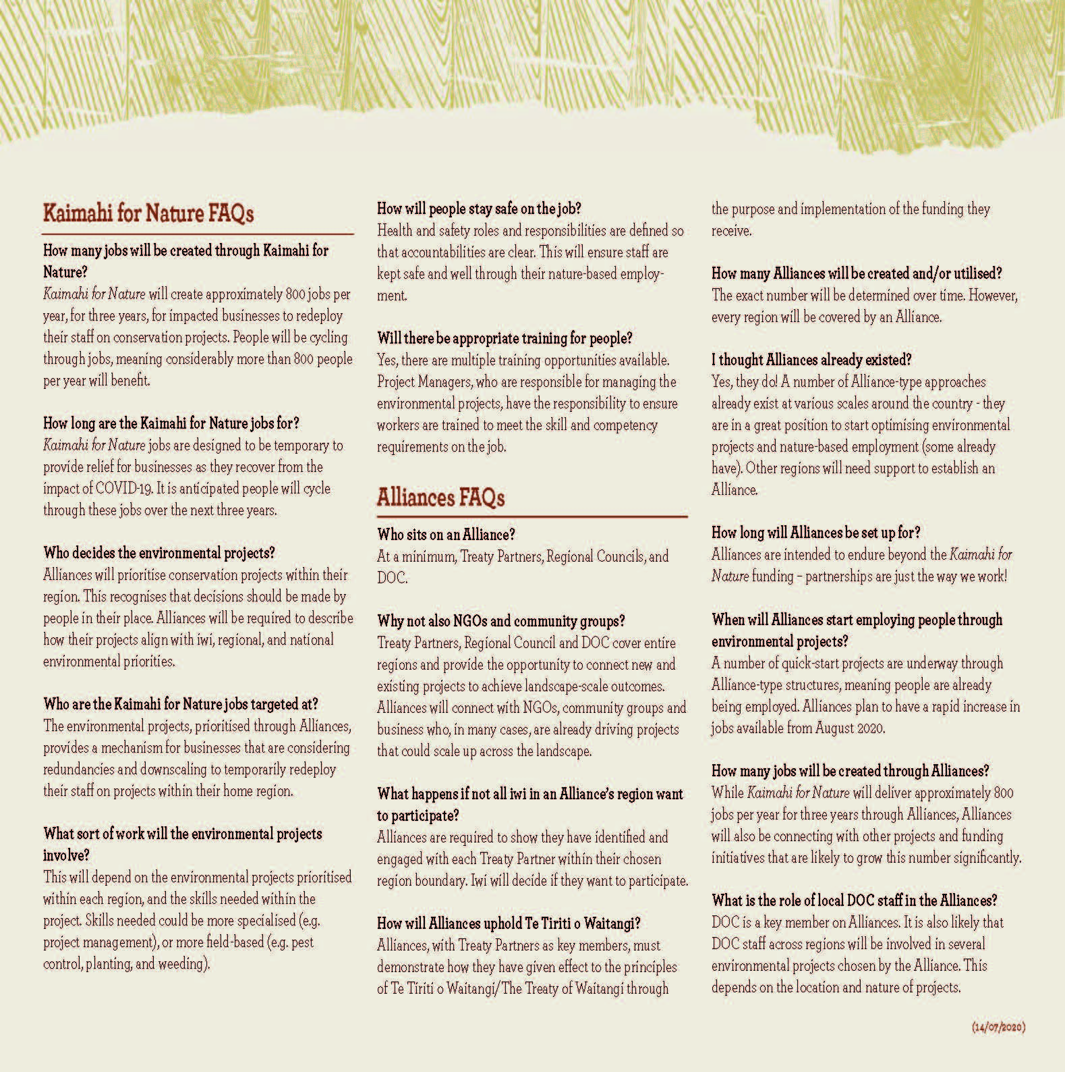
Handout 1 – page 2
How Alliances Create Jobs for Nature

Slide 12
Handout 2
Environmental Alliances, RLGs, RSLGs working together in Nelson

