Slide 1
Strategy into action
Gareth Bostock
Director Gambling Compliance Group
Notes:
Welcome – especially to those who haven’t attended one of our sector forums before.
For those of you who do attend regularly, you’ll have noticed that today’s agenda has been a bit different as we held a harm minimisation workshop this morning. We did this after receiving some requests from those in the sector to do more about our expectations about gamble host responsibilities. So hope those of you who were there found it useful and interesting.
Really good to see a cross section of the sector. We are very keen to build relationships across the different segments of the sector, rather than working in silos – which we can all be rather good at!
We want the sector to succeed. We’re all in this together and by working together we can tackle things in a smarter more connected fashion.

Slide 2
Notes:
By working together we can make things happen. Improvements can be made by all of us. I’m particularly looking forward to the session this afternoon about 3 year licences when we’ll discuss best practice and what that means to all of us.
Have a look at this video – which illustrates how smart things can get when people really work together
Play the video
I liken the car to the gambling system. The pit crew represents all of us in the sector, working together.
It’s slick isn’t it! Very impressive. There are no dropped spanners…no runaway wheels.
That’s my aim!

Slide 3
Notes:
We’ve definitely on the right road!
We have set out to build relationships with you and our annual gambling survey is telling us that’s happening. The results from the 2016 survey will be published shortly, but we already know from the draft report that there have been tangible improvements in how we work together and you’ve acknowledged that we’re getting better with how we engage with you - the sector.

Slide 4
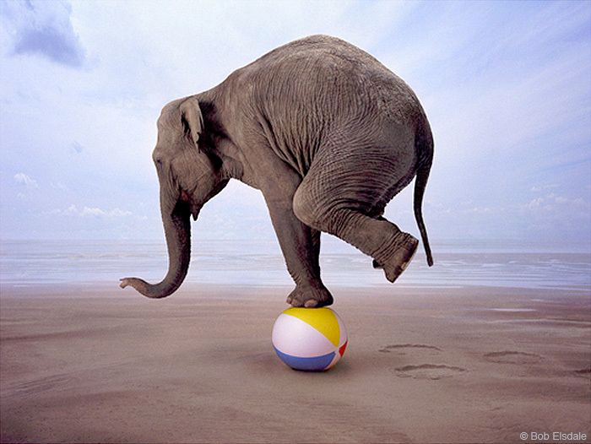
Notes:
We’re committed to collaboration – while acknowledging that it’s a balancing act. In any good relationship there will always need to be compromises. You may not always like our decisions and vice versa. Building and having a good relationship means better understanding and smarter regulation.
It doesn’t mean always agreeing with each other. But if we share a clear view of our desired outcomes we can align decision making to those outcomes.
We know that the sector’s challenges are complex – we’re not talking here about a simple task of following a recipe to bake a cake, but a complex issue akin to raising a child, where rigid protocols have a very limited application and success is not guaranteed.
With complex issues and systems there are many interdependent variables, feedback loops, context dependent decisions and often some unintended consequences. Did anyone say life was meant to be easy?!
We are aiming for a high trust environment, which can lead to increased speed of decisions and decreased cost.

Slide 5
Achievements
Licensing as a gateway
Venues
Audits
Notes:
In May this year, at our last forums, I outlined some of the things we were going to do….
I’d like to reflect on what’s been achieved this year.
We’ve already mentioned the improvement in our engagement with you and our desire to listen and collaborate.
Licensing as a gateway
Venues – we are in the middle of a project that’s looking at how we change / improve the way we inspect venues – and while that’s proving more complex than we first thought we are busy seeking to understand venues – their context better. We’re meeting with venue staff and collaborating with all parts of the sector to gain a better insight on how we can lift gamble host practice.
This includes (as those here this morning will know) our continued partnership with the Health Promotion Agency and we’ll see the rolling out early next year of a new training resource for venue staff.
Progress is also being made on improving the Multi Venue Exclusion process. That’s a cross-sector collaboration which is really good to see and I’m confident it’ll bear fruit next year.
Audits
With these initiatives and our on-going projects the focus is on working with you, understanding context, using discretion and addressing risk.

Slide 6
Notes:
One of our other achievements this year is the production of this online booklet which promotes some of the great things you do for the community.
The booklet takes a look at 10 community organisations which benefit from pokie proceeds.
This is a very small way of promoting the good things that happen that benefit communities. Some people have been critical of the initiative as they see it as promoting gambling. It isn’t of course. It’s all about the fact that the NZ gambling model sees a trade off between gambling harm and community benefit.

Slide 7
Notes:
First – very pleased that the Minister Peter Dunne was delighted with the booklet and has written the foreword.
Let me flick through some of the stories too give you a taste of what the booklet looks like – and I’ve just highlighted some of the ones particularly relevant to this audience!

Slide 8
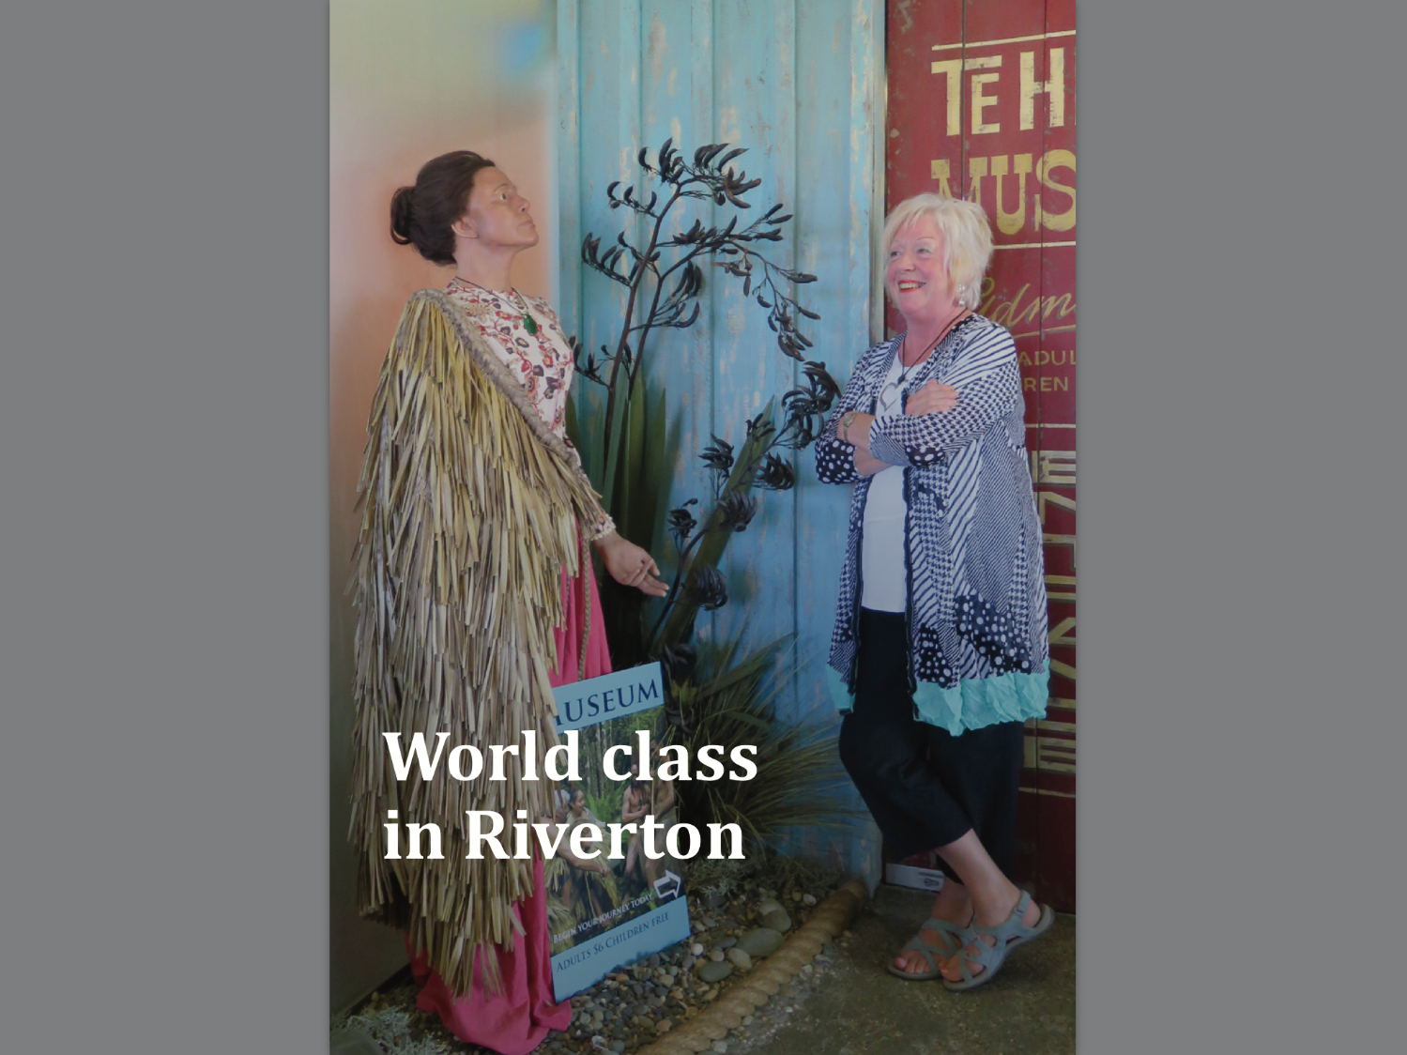
Notes:
Who recognizes this? This story is about Te Hikoi museum in Riverton. A cause supported by Southern Victorian

Slide 9
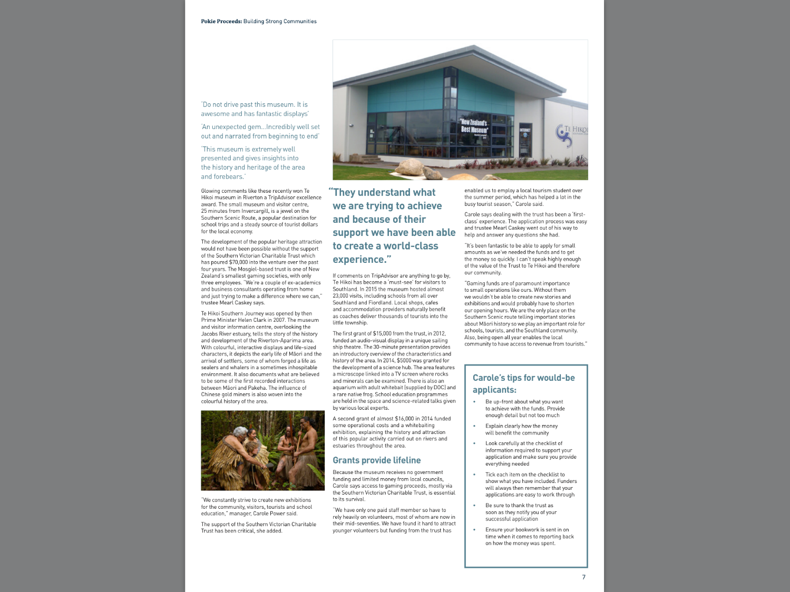

Slide 10
Notes:
This story is about helping young people in South Auckland – an initiative supported by Southern Trust

Slide 11
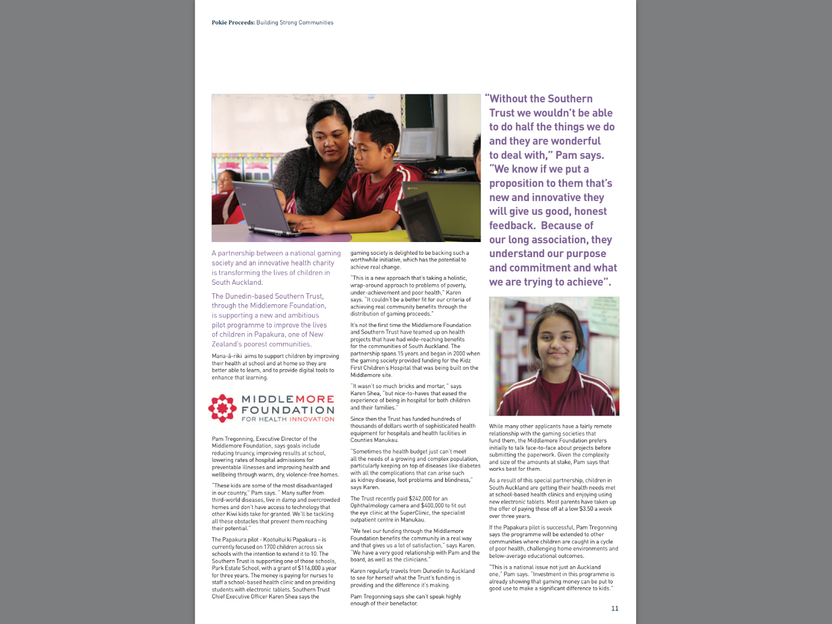

Slide 12
Notes:
The Dunedin physio pool
Huge variety of good causes – and of cause the ten stories can only touch on some.

Slide 13
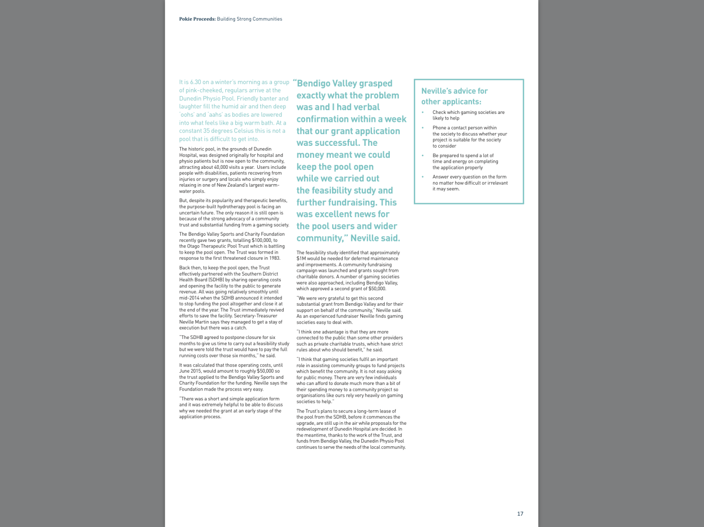

Slide 14
Notes:
Mosgiel elderly care

Slide 15
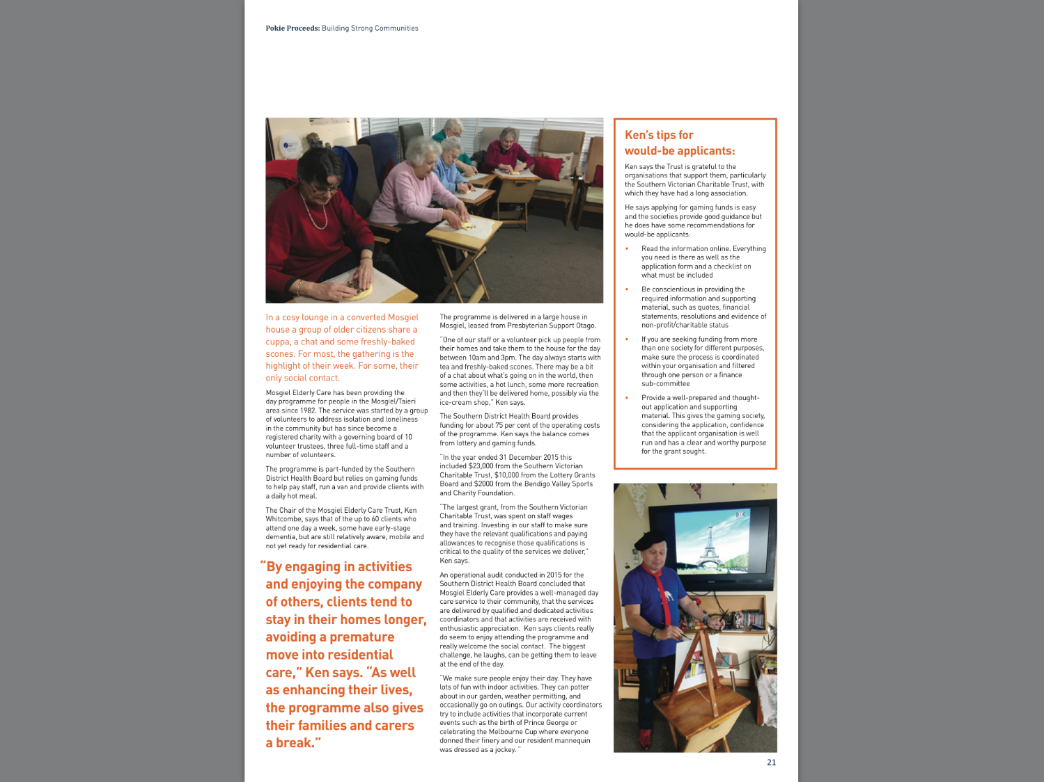

Slide 16
Notes:
Variety Theatre in Ashburton – helped by Lion Foundation

Slide 17
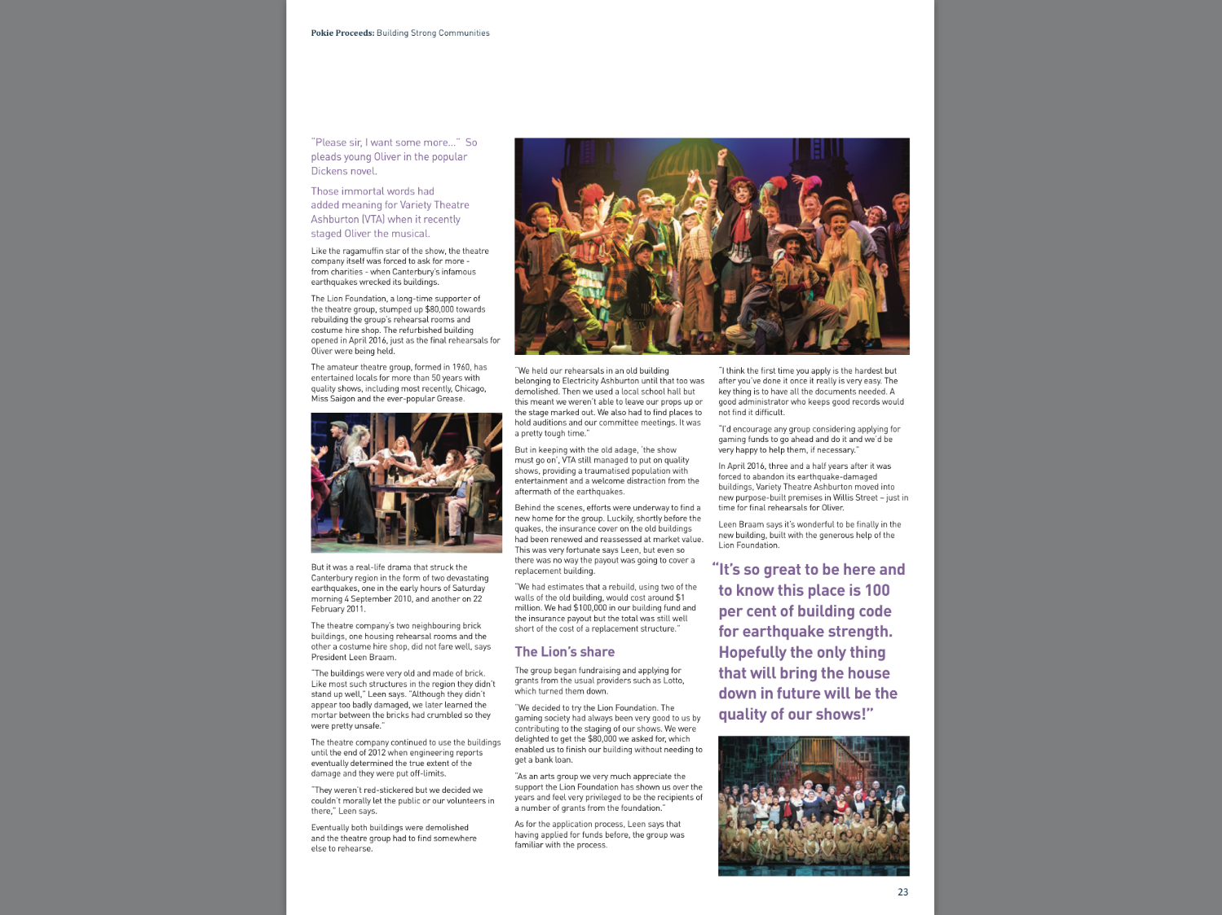

Slide 18
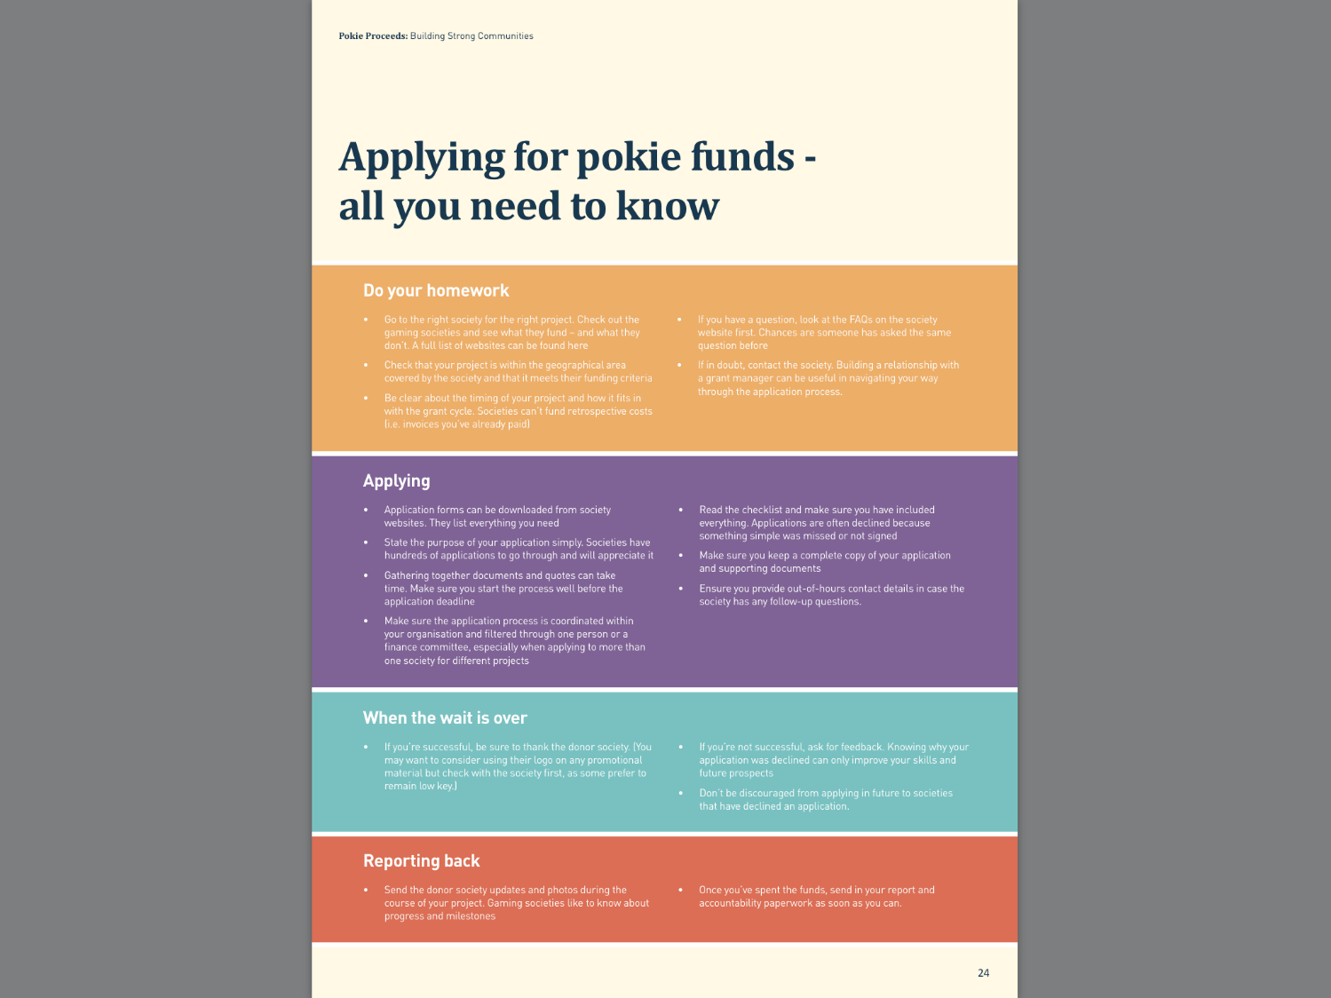
Notes:
You may have noticed that a lot of the stories contain tips for would be applicants.
There is also this page that provides advice on applying for funds – so this may go a small way to improve the quality of applications.
Hope you like this resource. Thank you to those who offered up good stories and helped us with the application tips.
The booklet will sit on our website – it’s designed as an online resource. Although we have printed off a couple of hard copies which we have here as we thought you might like to flick through it.
We’ll be putting out a Gambits very shortly which will have the link to the booklet. We’d love it if you would link to the booklet or host it on your websites. You might even want to put a link to it on your grant application forms.
We’ll be looking at ways to promote it in different ways. Keen to balance our work aimed at improving gambling host responsibility with a focus on the benefit to communities of pokie grant funding.
And we’re already thinking we may do subsequent editions in future years so we can showcase a lot more good causes which receive benefit from pokie proceeds.
So that’s a small snapshot of what we’ve been up to in 2016. I think we’re making real progress and I’m looking forward to continuing my secondment as Director into 2017.

