Slide 1
Gambling Host Responsibility Logbooks

Slide 2
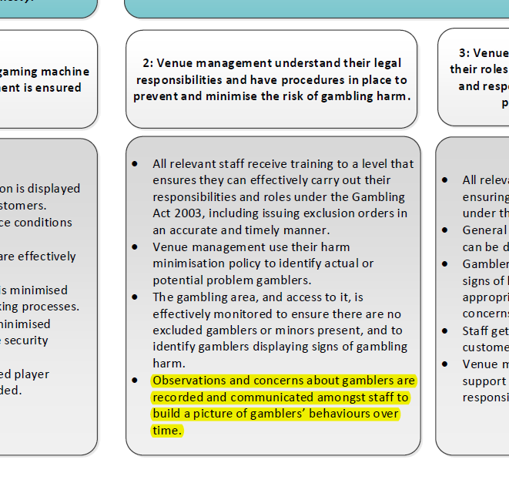
Why is it important?

Slide 3
Let’s look at an example…
What would you note in your logbook?

Slide 4
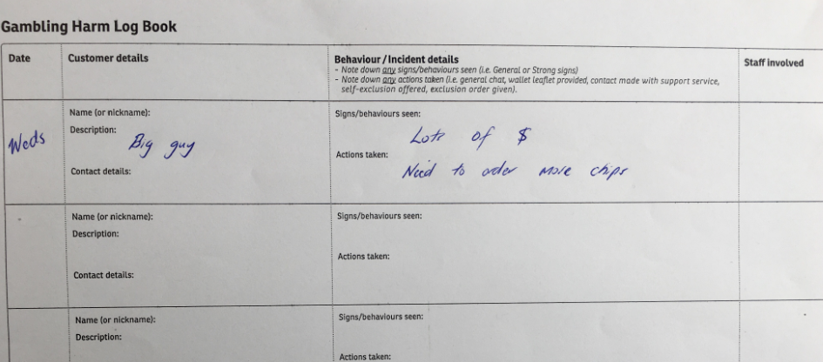
Let’s look at a not so good example…

Slide 5
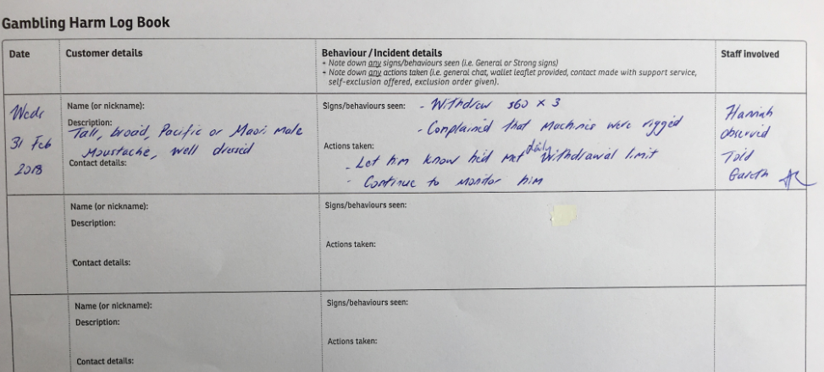
Let’s look at a great example…

Slide 6
Key tips for logbook entries
Focused solely on gambling
Frequent entries
Customer descriptions are detailed and specific
General and strong signs are recorded
Clear account of actions taken are documented
Regularly check logbook to identify patterns
Follow up on identified gamblers displaying signs of harm, escalate if needed

Slide 7
Any Questions?

