Slide 1
Gambling Host Responsibility Resources

Slide 2
Introduction
Gambling host responsibility is challenging, BUT there are resources to help you
Why were these developed?
How were they developed?
How are they being used?

Slide 3
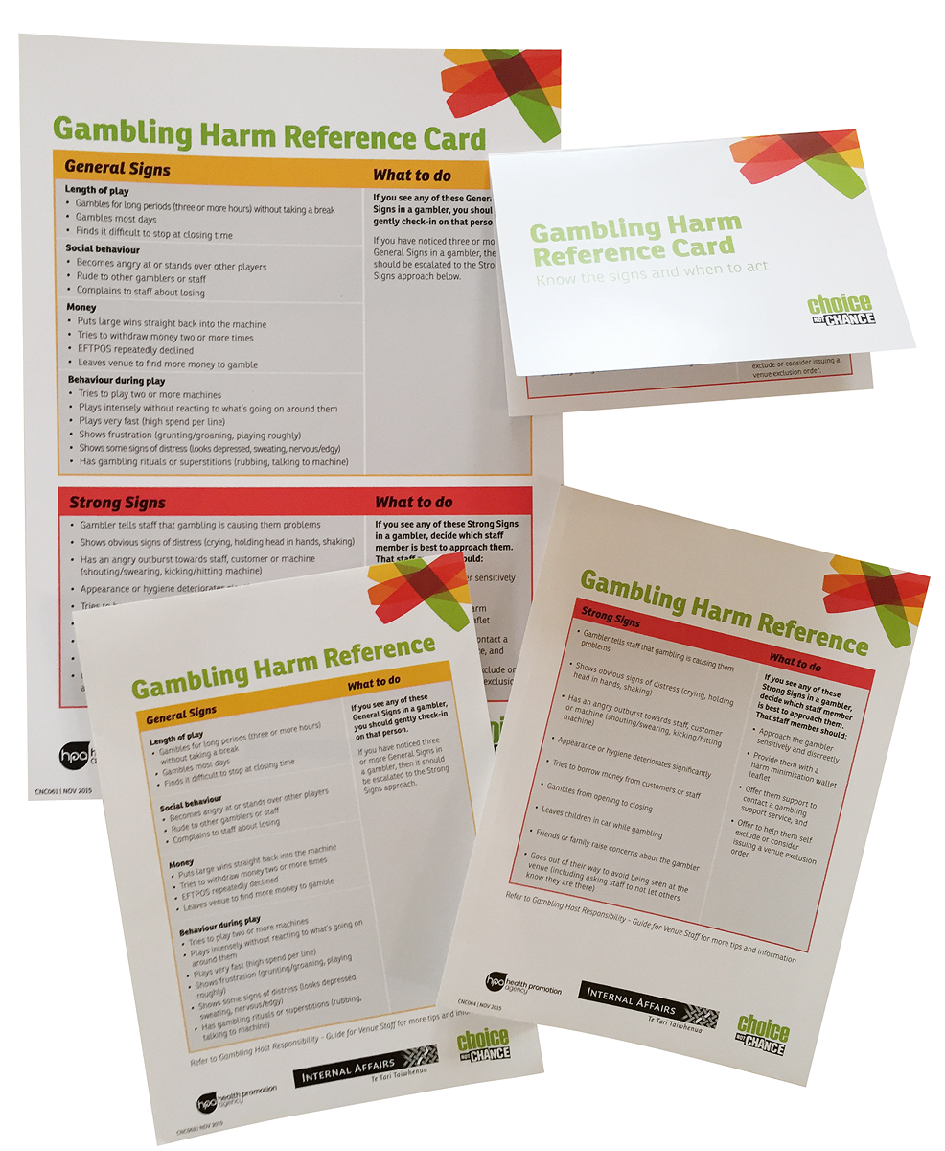
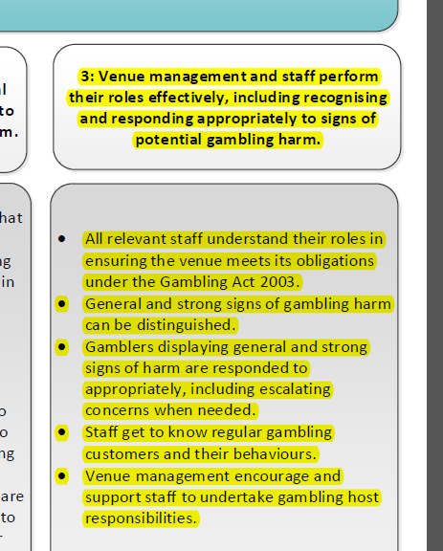
Gamble Host Resources

Slide 4
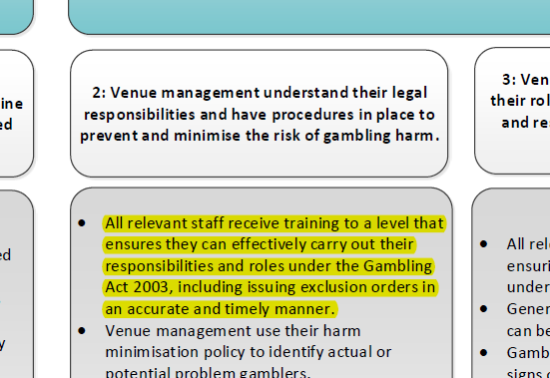
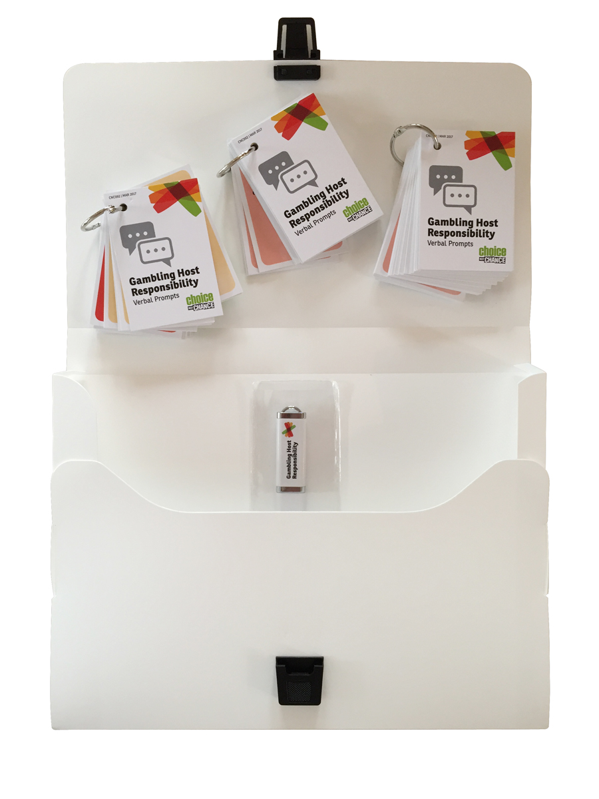
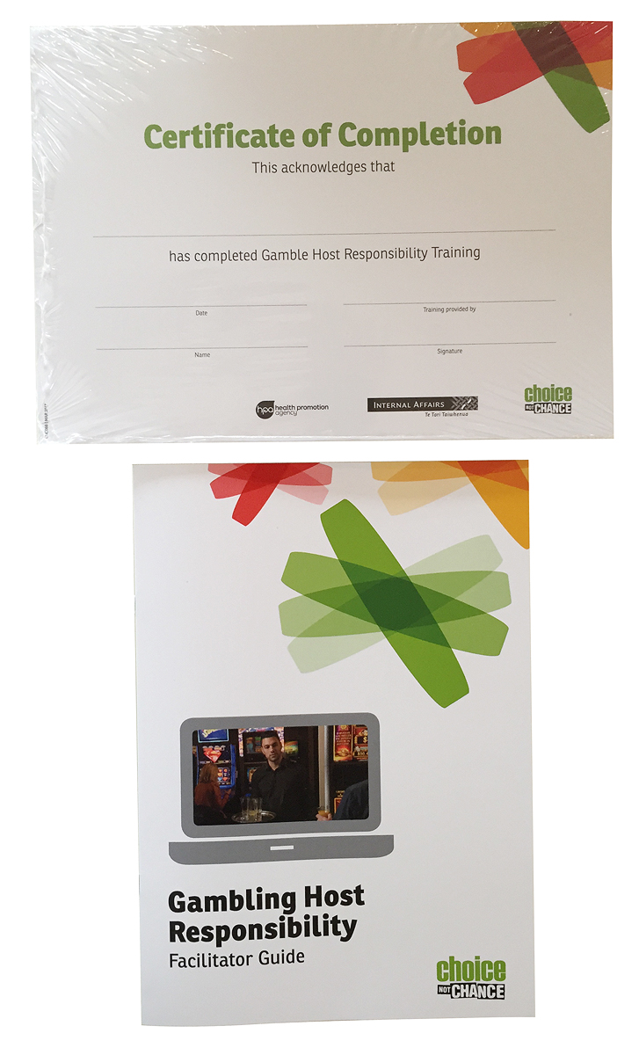
Gamble Host Training Packs

Slide 5
Gamble Host Website - https://gamblehostpack.choicenotchance.org.nz/

Slide 6
Staff Resources

Slide 7
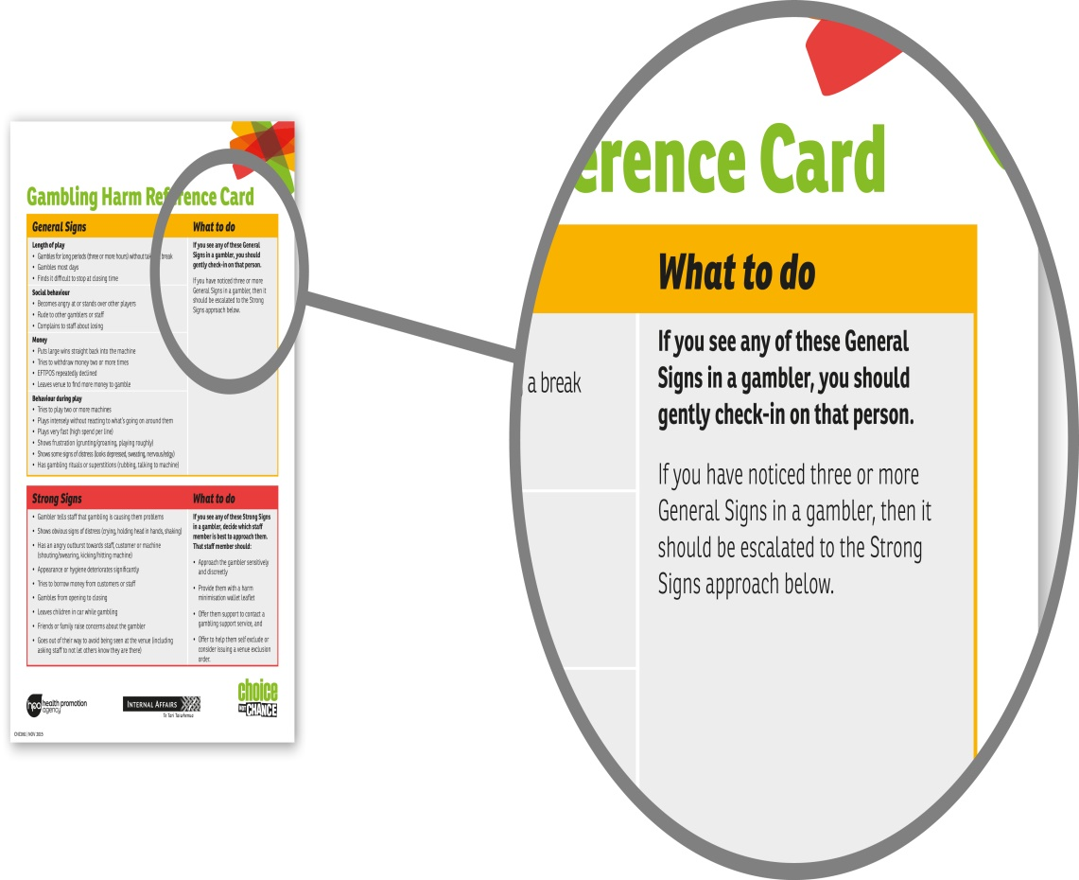
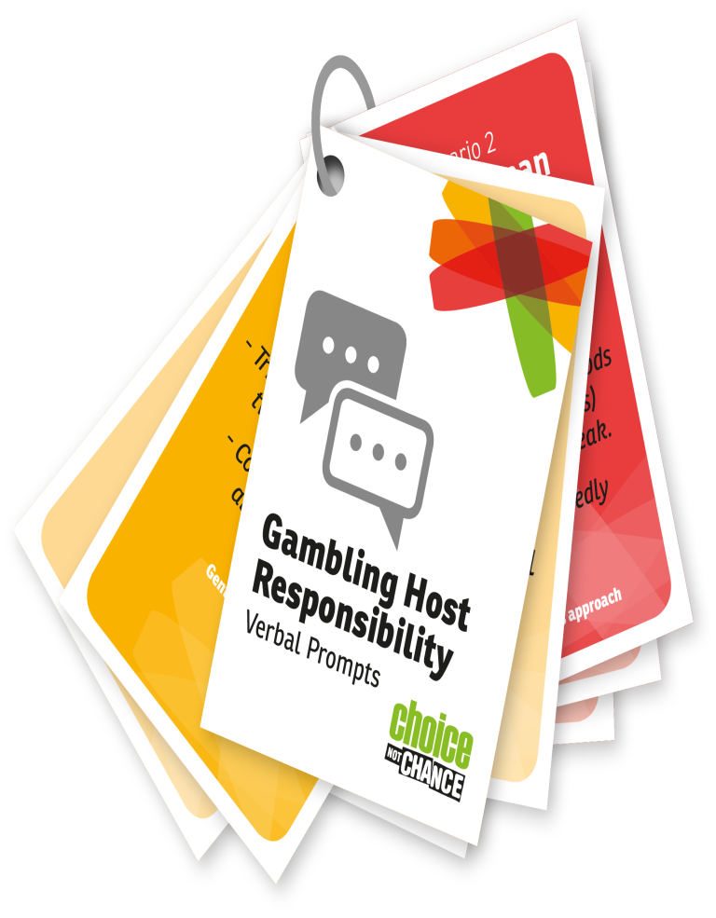

Slide 8
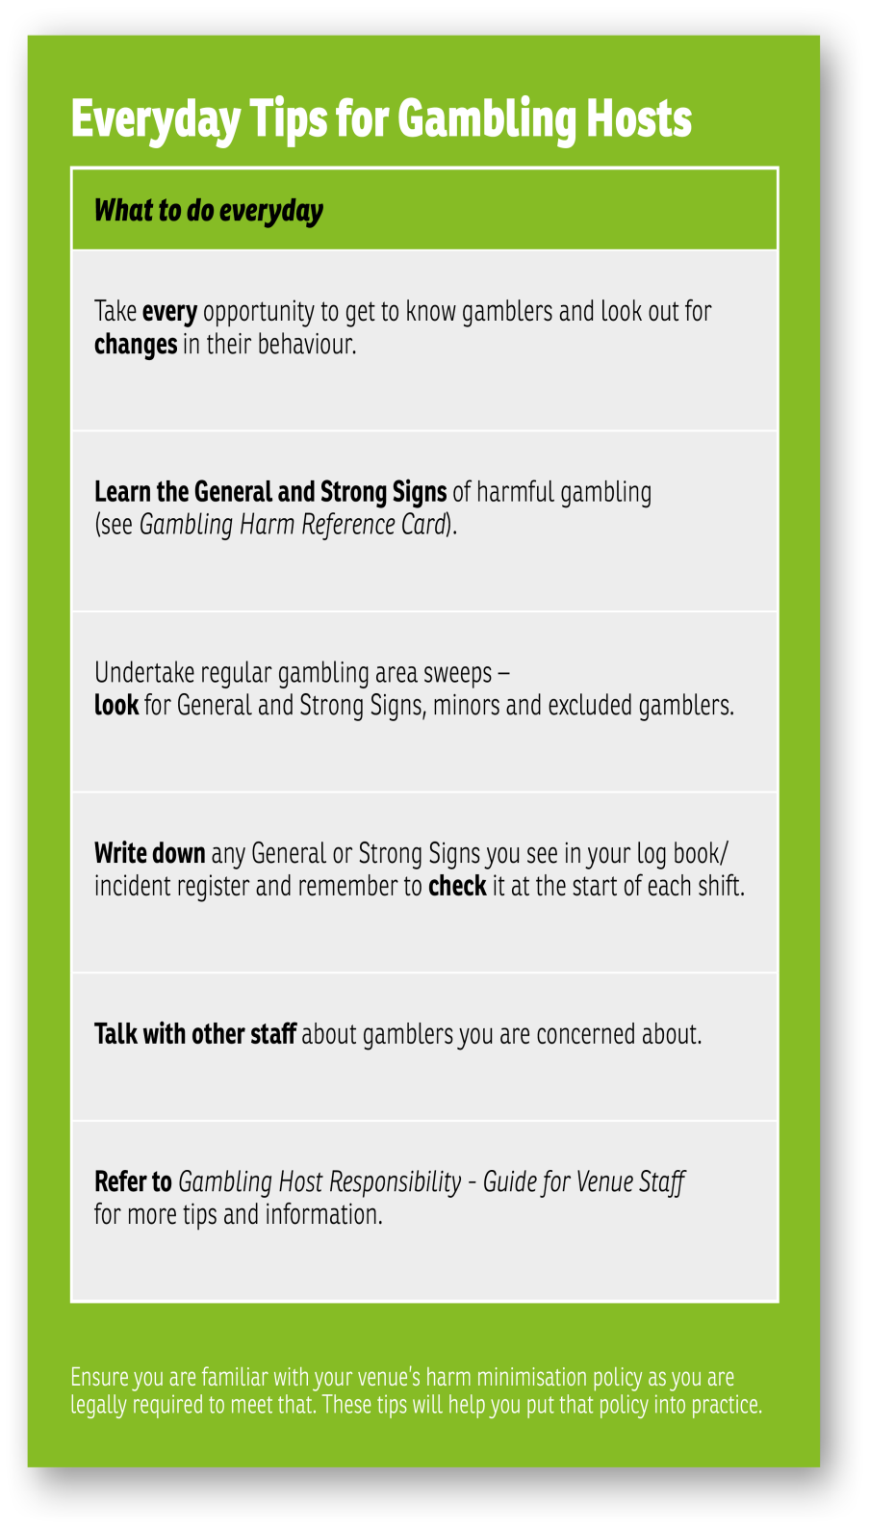

Slide 9
Staff Meetings

Slide 10
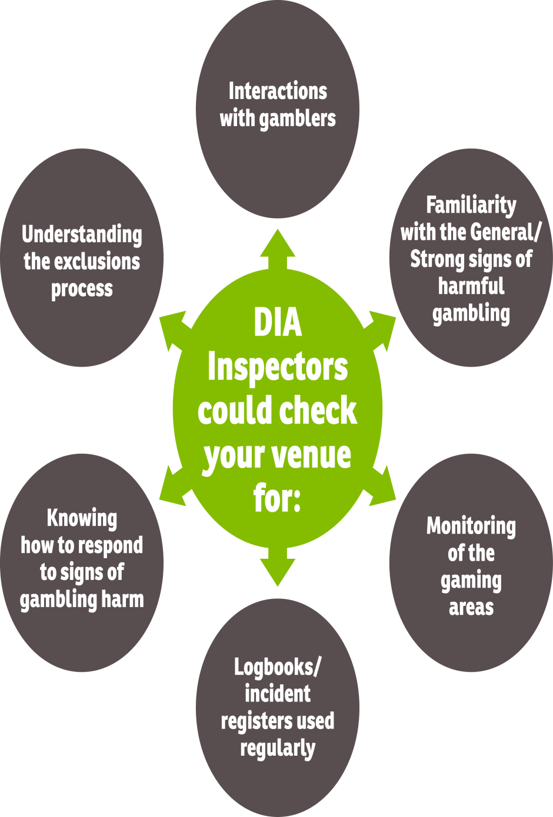
What can we expect from DIA venue assessments?

Slide 11
Which of these people has a problem with their gambling?
It could be any one of these people.
There are however some clear signs to look for.

Slide 12
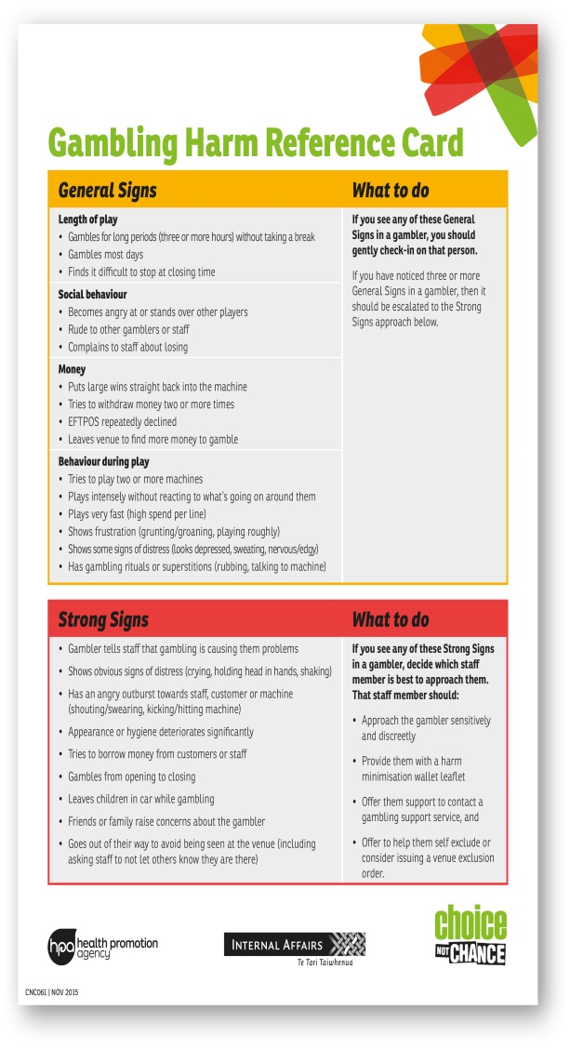
Can you spot the General/Strong Signs?

Slide 14
Posters and Pamphlets

Slide 15
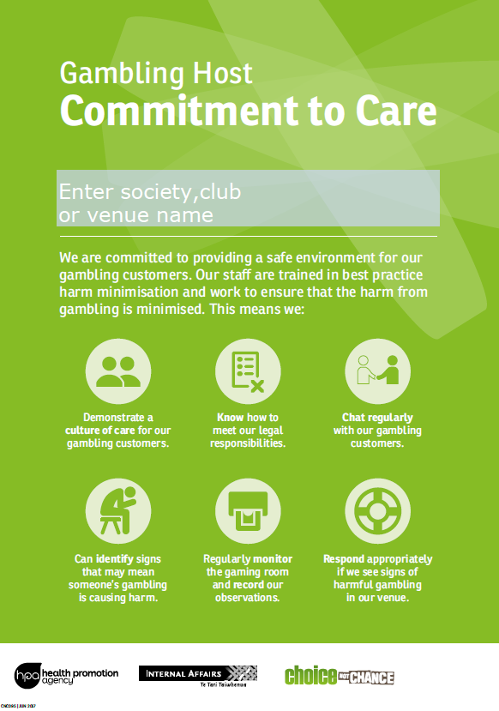

Slide 18
Other Support

Slide 19
Ongoing support
https://gamblehostpack.choicenotchance.org.nz/
Your Society representative
DIA Gambling Inspectors
Gambling Helpline and local services
(minimising gambling harm)
Local support services – how they might help
Come and chat about services available
Localise resources
Meet and greet at staff meeting
Assisting with in-house training
Refer clients to them
Support excluded gamblers
Liaise about exclusion breaches

Slide 20
Any Questions?

