Slide 1
Culture eats strategy for breakfast.
Notes:
We want these workshops to be a two-way street – we want to understand each other and work together.
This presentation has a strange title, but it refers to the fact that the best plans and approach will fail if the culture isn’t right.
Strategy is a plan of action designed to achieve a long-term or overall aim.
Culture is a set of attitudes and beliefs that belong to a group. It’s about doing the right thing and encouraging the people in that group to understand why doing the right thing matters. When the whole group wants to do the right thing and knows why they should do the right thing, that culture is more powerful and meaningful than a set of rules, or strategy.
It’s why we want to promote a culture of care, internally and externally in the gambling system.

Slide 3
The NZ Gambling Framework
BENEFITS
Licensing system
Grants
Social Capital
Entertainment
Strong Communities
Gambling harm
Game integrity
Fairness / fraud
TRUSTED & TRANSPARENT
CONSUMER
PROTECTION
Notes:
Balancing all three sections leads to strong communities.

Slide 4
Trusted and Transparent
“The licensing and monitoring system cannot function if the regulators are deceived as to the identity of who is involved”
Offence surrounding community money
Failing to give truthful disclosure is a breach of trust
Deliberately false representations or omissions are a serious compliance matter
Notes:
There were important lessons to be learned from this case (Operation Chestnut)– it was significant and set a precedent.
The High Court judge commented that the Department must be able to rely on the accuracy of information provided to it.
From judgement: Misleading the regulator or failing to provide information influences regulatory decisions. This is a serious compliance matter.

Slide 5
Braithwaite Triangle
Attitudes
Our response
Decide not to comply
Use the full force of the law
Do not want to comply
Deter by detection and administration action
Try to comply but do not always succeed
Support to comply
Are willing to do the right thing
Make it straight forward to comply
Notes:
We’ve are a responsive risk-based regulator. We want to understand your world and work together to reduce risk and get a better outcome for New Zealanders.

Slide 6
Changing our culture…
“We make them comply”
Everyone works to continually improve gambling practice
Highlight failings
Influencing behaviour /solution focus
Information gathered used to ensure compliance
Information gathered is shared with sector, and informs where to next
Broader range of activity to balance outcomes of market sustainability, harms, community benefit, sector integrity, and enjoyment
Outputs (license, inspect, audit, investigate, enforcement action)
Reactive
Proactive, target by risk
Mutually driven, proactive engagement
Regulator driven engagement
Understand operator’s environment and capability

Slide 7
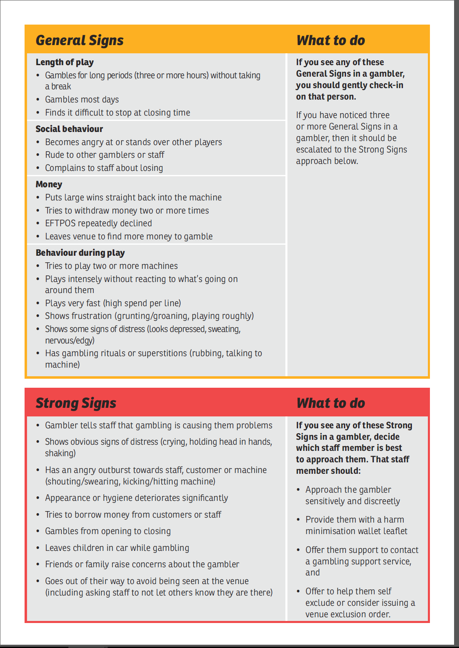
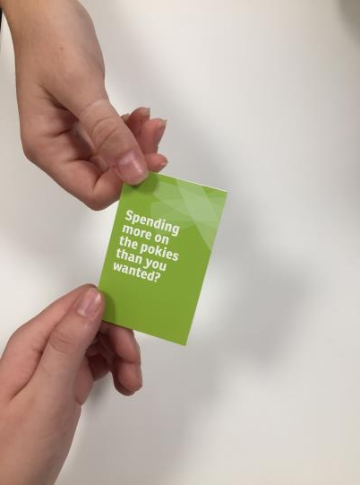
Department Expectations
Notes:
Just as we have recognised the need to change and move forward we also expect the sector to do so.
The Health Promotion Agency (HPA) and the Department have tools to support you in your responsibilities, including venue training resources and packs.
It boils down to:
Taking an interest in gamblers
Knowing what to look for
Acting on signs
Recording what happened
CARING about what goes on in your venue.

Slide 8
Culture of Care
https://www.youtube.com/watch?v=btJ4IIFHjvc&t=1s
Notes:
A culture of care means:
Building relationships and taking time to speak to customers.
Looking out for the signs you’ve been trained to look out for. Offering them the chance to come away from the gaming area and have a chat for a couple of minutes (you could offer them a free tea or coffee).
A manager that supports staff to care for their customers
Having a policy so that all staff know what to do.
In the video when Baylee says “everyone that comes into our venue is important” – that’s the kind of culture of care we are after.

Slide 9
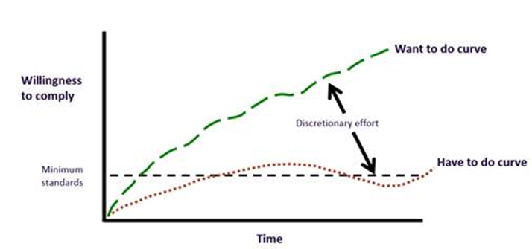
Good Practice
Notes:
We want to move from the bottom line, which is what we have to do under the Act and regulations, to the top line, where we are caring about our customers and continually improving practice.
To get there will involve some discretionary effort. So why should we make that effort?
We believe that times change far faster than laws and regulations. We want to change with the times before we have change imposed on us. We also want an enhanced sector reputation and sustainability. We want safer gambling environments. But mostly, we make the effort because we care about our customers.

Slide 10
Harm Minimisation
Framework
Harm Minimisation Policy
Outcome-focused
Tools
Education
Training
Resources
Exclusion orders
Mystery shopper
Venue assessments
ENGAGEMENT
Licensing
Outcome
Notes:
These are the tools that we will talk about today. We’ll use them all to help us improve harm minimisation across the sector. The things we learn from these tools will influence our licensing decisions and outcomes.
All of this will be done with engagement throughout.

Slide 11
Some Outcomes So Far…
of pokie trusts agree their venues are better supported to minimise gambling harm [DIA May 2015 sector forum survey]
of pokie trusts found the materials useful [DIA May 2015 sector forum survey]
percentage increase of gamblers who had interaction with venue staff between 2014 and 2016 [Health and Lifestyles survey]
Notes:
So how have we done so far? This data is a bit out of date, and we hope these numbers would be even higher now.

Slide 12
Questions

