Slide 1
DIA Regional Forums
May 2016
Ministry of Health Update
tai_kake@moh.govt.nz

Slide 2
Whakatauāki
He aha te me nui o te ao?
He tangata, he tangata, he tangata
What is the most important thing in the world?
It is people, it is people, it is people

Slide 3
Goals
New Strategy to Prevent and Minimise Gambling Harm (2016/17 to 2018/19)
Key research findings and current projects
Signal upcoming Innovation round

Slide 4
Gambling Act 2003
Section 317
An integrated problem gambling strategy must include—
measures to promote public health by preventing and minimising the harm from gambling; and
services to treat and assist problem gamblers and their families and whanau; and
independent scientific research associated with gambling, including (for example) longitudinal research on the social and economic impacts of gambling, particularly the impacts on different cultural groups; and evaluation.
Section 318
requirement to consult about the overall strategy
undertake a needs assessment
develop costings

Slide 5
Strategic context
Current Preventing and Minimising Gambling Harm Strategic Plan ends 30 June 2016.
New Cabinet approved plan (2016/17 to 2018/19) released 27 May 2016.
Available on Ministry website or hard copies can be ordered.

Slide 6
National Gambling Study-Wave 2 key findings
March 2012-Dec 2015, 6251 adult New Zealanders
Overall gambling participation slightly lower
77.9% NZ adults participated in 2013 at least once, slightly lower than 80% in 2012
14% or 462,140 adults gambled on non-casino gaming machines at last once in 2013.
Some risk factors for gambling harm have decreased
decrease in adults who engaged in multiple gambling activities (from 3.3% to 2.0%).
monthly participation in overall EGM gambling decreased slightly (from 4.9% to 3.4%)
New Problem Gamblers
About 8,046 people were ‘new’ problem gamblers in Wave 2 (0.28%). 4000 of these were ‘completely new’ problem gamblers.

Slide 7
National Gambling Study-Wave 2 key findings
Prevalence of problem gambling slightly lower**
About 23,504 New Zealanders were problem gamblers in 2012 (0.7%)
Approx. 16,205 adults were problem gamblers in 2013 (0.5%)
About 50,000 adults (1.5 %) were moderate risk gamblers in 2013, compared to about 60,000 in 2012 (1.8%)
Approx. 167,888 people were lower risk gamblers in 2013, similar to 2012
Inequalities are enduring
Māori and Pacific peoples continued to have 3 to 4 times higher rates of problem gambling and moderate risk gambling
**confidence intervals overlap so may not be statistically significant

Slide 8
National Gambling Study-Wave 2 key findings
Harm associated with EGMs or pokies
The harm associated with non-casino EGMs is significantly higher than for other gambling activities such as Lotto.
The prevalence of problem and moderate risk gambling amongst non-casino gamblers is 2.7% (12, 477 people) and 8.7% (40,206 people) respectively.
Approximately half of the clients presenting to our gambling harm services identify non-casino gaming machines as causing them problems. This is by far the largest group of clients associated with a particular gambling mode.

Slide 9
Telephone-based clinical trial
Aims
Compare the effectiveness and durability of the standard gambling helpline treatment with three other types of treatments, one of which included a novel intensive treatment
Involved 462 callers to the gambling helpline (all problem gamblers)
Results
At 3 years, the most intensive treatment was most effective, with 50% fewer clients still problem gamblers
Clients in the intensive group had an average PGSI score of 1 (low risk) compared to 3, 5, and 7 for the other treatments (moderate risk).
Translation into practice
Ministry is working with the new helpline provider (Home Care Medical) to implement the new intensive treatment into business as usual this year.

Slide 10
Face-to-Face clinical trial
Aims
Evaluate the effectiveness of :
face-to-face motivational interviewing combined with a self-instruction booklet and follow-up telephone ‘booster’ sessions (MI+W+B)
face-to-face cognitive behaviour therapy (CBT).
post-treatment text messaging in preventing relapse and sustaining treatment gains at 12 and 24 months.
Translational service aims
1. Develop and implement ways to integrate two evidence-based interventions into the everyday operations of face-to-face gambling counselling services and ensure the integrity and consistency of their delivery to clients.
2. Customisation: Inform the development of tailored, flexible and targeted interventions for a variety of client groups, .

Slide 11
Smart-phone based application feasibility study
Aims
develop and test a novel smartphone application (“app”) to see if it is a feasible way to provide additional support to people with gambling problems associated with EGMs
Based on Marlatt’s cognitive-behavioural relapse prevention model.
Methods
Technical and field testing the prototype app for accuracy, coverage and use with different smartphone operating systems
Focus groups with 46 people with gambling problems and 10 service counsellors.
Separate focus groups were held for Māori, Pacific and Asian people, led by facilitators of the same ethnic group.

Slide 12
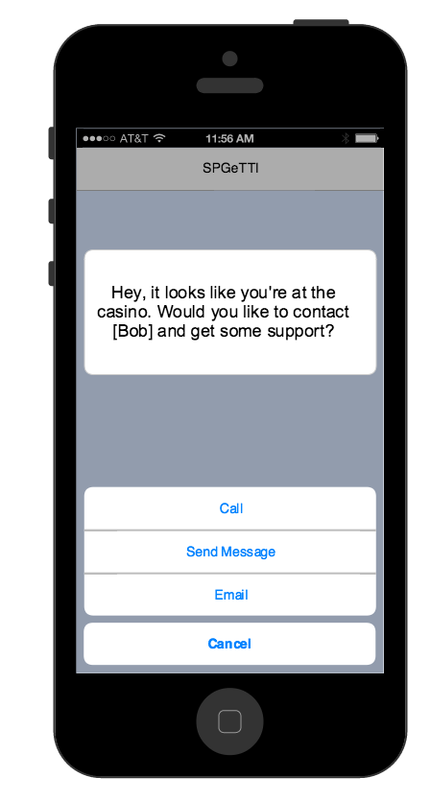
Smart-phone based application study

Slide 13
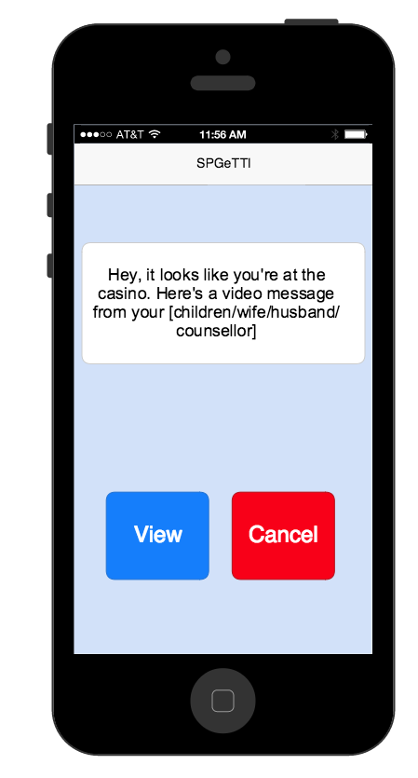
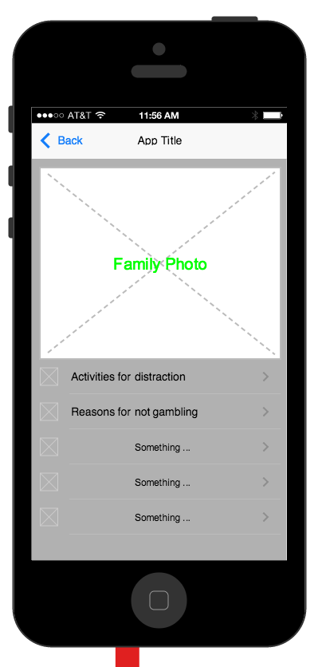
Smart-phone based application study

Slide 14
Smart-phone based application feasibility study
Results
Clients and counsellors supportive of the ‘APP’
General support for personalised messages tailored for different languages, stage of recovery, likely risky times of day
Strong support for messages about the potential for adverse consequences of relapse
The hypothetical potential risk for the ‘APP’ to trigger gambling should be carefully assessed in a clinical trial

Slide 15
Smart-phone based application for problem gambling
Quote from Māori participant
“that would be good because I’m not the one to think much of myself at all, but to have something like that, like ‘aw, congratulations, awesome job’ you know ‘ you passed the casino’ …it’s like aw sweet!”
Next Steps
Additional features: internet site blocking
Full clinical trial starts in June

Slide 16
Innovation research round
Key elements
New and innovative
Practical benefits and outcome focussed
Value for Money
Address gambling-related harm and strategic priorities
Section 317 requirement of ‘independent research’
Sept/Oct 2016
GETS release www.gets.govt.nz

Slide 17
QUIZ
Q1: How many completely ‘new’ problem gamblers are there in the NZ population per year?
Q2: Which groups currently have the highest rates of problem gambling?
Q3: What is an example of research being used to improve service outcomes for clients?
tai_kake@moh.govt.nz

Slide 18

Break Out

Slide 19
Total Client Presentations by Ethnicity: 2012 to 2015
All Interventions
Ethnicity | 2012- 2013 |  | 2013 - 2014 |  | 2014 - 2015
East Asian | 735 | 5.9% | 712 | 5.6% | 1005 | 7.9%
Māori | 4317 | 34.7% | 4564 | 36.1% | 4457 | 35.0%
Other | 5097 | 41.0% | 4852 | 38.4% | 4586 | 36.0%
Pacific | 2289 | 18.4% | 2499 | 19.8% | 2693 | 21.1%
Total | 12438 |  | 12627 |  | 12741
Full Interventions
Ethnicity | 2012 - 2013 |  | 2013 - 2014 |  |  | 2014 - 2015
East Asian | 428 | 6.2% | 474 |  | 6.6% | 477 | 6.6%
Māori | 2077 | 30.0% | 2120 |  | 29.4% | 2163 | 30.0%
Other | 2835 | 40.9% | 2942 |  | 40.9% | 2974 | 41.2%
Pacific | 1591 | 23.0% | 1664 |  | 23.1% | 1597 | 22.1%
Total | 6931 |  | 7200 |  |  | 7211

Slide 20
Problem Gambling Severity Index PGSI
Thinking about the last 12 months…
1.Have you bet more than you could really afford to lose?
Never=0 Sometimes=1 Most of the time=2 Almost always=3
2. Still thinking about the last 12 month, have you needed to gamble with larger amounts of money to get the same feeling of excitement?
Never=0 Sometimes=1 Most of the time=2 Almost always=3
3. When you gambled, did you go back another day to try to win back the money you lost?
Never=0 Sometimes=1 Most of the time=2 Almost always=3
4. Have you borrowed money or sold anything to get money to gamble?
Never=0 Sometimes=1 Most of the time=2 Almost always=3
5. Have you felt that you might have a problem with gambling?
Never=0 Sometimes=1 Most of the time=2 Almost always=3
6. Has gambling caused you any health problems, including stress or anxiety?
Never=0 Sometimes=1 Most of the time=2 Almost always=3
7. Have people criticized your betting or told you that you had a gambling problem, regardless of whether or not you thought it was true?
Never=0 Sometimes=1 Most of the time=2 Almost always=3

Slide 21
Problem Gambling Severity Index PGSI cont.d
8. Has your gambling caused any financial problems for you or your household?
Never=0 Sometimes=1 Most of the time=2 Almost always=3
9. Have you felt guilty about the way you gamble or what happens when you gamble?
Never=0 Sometimes=1 Most of the time=2 Almost always=3
Total your score. The higher your score the greater the risk
Score the following for each response:
never = 0 sometimes = 1
most of the time = 2 almost always = 3
Scores for the nine items are summed
0 = Non-problem gambling.
1-2 = Low level of problems with few or no identified negative consequences.
3-7 = Moderate level of problems leading to some negative consequences.
8 or more = Problem gambling with negative consequences and a possible loss of control.

