Slide 1
Funding for maximum impact
Regional Gambling Sector forum

Slide 2
Sport does well from Class 4

Slide 3
Class 4 as part of total sport funding
National and Local Government
Statutory Organisations
$1.5B (58%)
$0.22B (8%)
•
Territorial Authorities $700m
•
Gaming $120m
•
Tertiary $300m
•
Lotteries
Sport NZ $50m
•
Conservation $167m
•
Community Trusts $20m
•
Primary Ed $136m
•
Energy Trusts $10m
•
Secondary Ed $100m
•
Lotteries facilities $10m
•
Sport NZ $80m
•
NZRB $10m
•
Health $10m
•
Licensing Trusts $1m
•
ACC $10m
$2.6B
•
Casinos $1m
•
MBIE $5m
Participants
$0.67B (26%)
•
Participation charges $296m
Business and Personal
•
Subscriptions $193m
$0.22B (8%)
•
Tuition fees $93m
•
Commercial $145m
•
Admission and hire of equipment $93m
•
Donations/b
equests $75m

Slide 4
Class 4 as part of liquid funding
National and Local Government
Statutory organisations
$0.1B (8%)
$0.22B (18%)
•
Gaming $120m
•
Lotteries
Sport NZ $50m
•
Community Trusts $20m
•
Energy Trusts $10m
•
Lotteries facilities $10m
•
Sport NZ $80m
•
NZRB $7m
•
Health $10m
Liquid
•
Licensing Trusts $1m
•
ACC $10m
•
Casinos $1m
•
MBIE $5m
$1.2B
Participants
$0.67B (56%)
•
Participation charges $296m
Business and Personal
•
Subscriptions $193m
$0.22B (18%)
•
Tuition fees $93m
•
Commercial $145m
•
Admission and hire of equipment $93m
•
Donations/bequests $75m

Slide 5
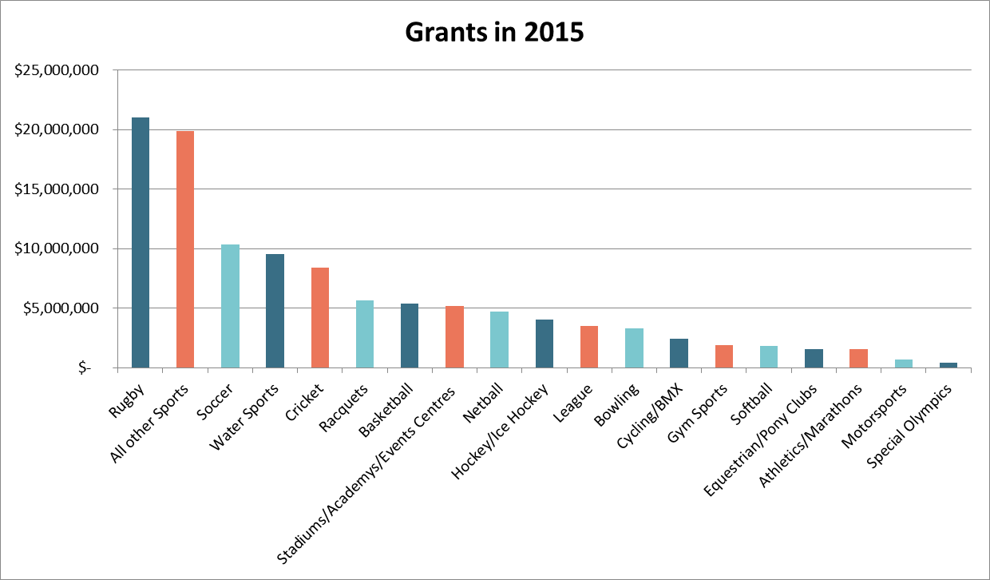
Recipients

Slide 6
For what – distribution by purpose

Slide 7
Sport sector feedback to Class 4
Critical source of funding
Getting noticeably harder for national bodies to source
Getting noticeably harder to apply for people costs
Importance of alignment of funds to strategic direction
Variable understanding that gaming trusts have different funding priorities and criteria
Difficult to forward plan given uncertainty of funding
Preference for annual application (as applied by some trusts) vs monthly applications (applied by others)
Decreasing reticence about association with gambling

Slide 8
Understand your world
Pressure on supply of funds
2004-2016 decrease in
Venues 42% (2,100-1,200)
Machines 32% (23,800 - 16,300)
Revenue 40% ($1.3b – $818m)
Local Govt sinking lid
Hearing voice of harm, not voice of community good
Competition for discretionary gambling $

Slide 9
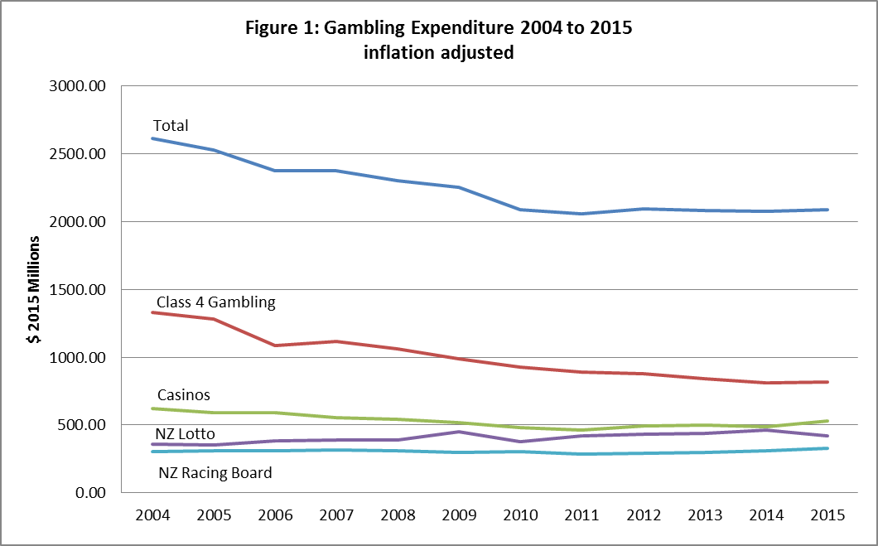

Slide 10
Understand your world
Playing field
Relatively high taxes
Inability to self-promote
Some ongoing poor behaviour
Pressure to get money out door
Review
Most if not all of above would be assisted by demonstration of greater impact

Slide 11
Impact
Good on You!
Did you know that over 3,000 projects receive lottery funding each year?
By playing Lotto you help upgrade sports grounds and fund conservation projects, rescue services, health research, the arts and much more.
Want to know more about where the money goes? Watch our Good on You clips to find out how Lotto funding is changing lives across New Zealand.
Good on you Lotto players! When you play Lotto the community wins

Slide 13
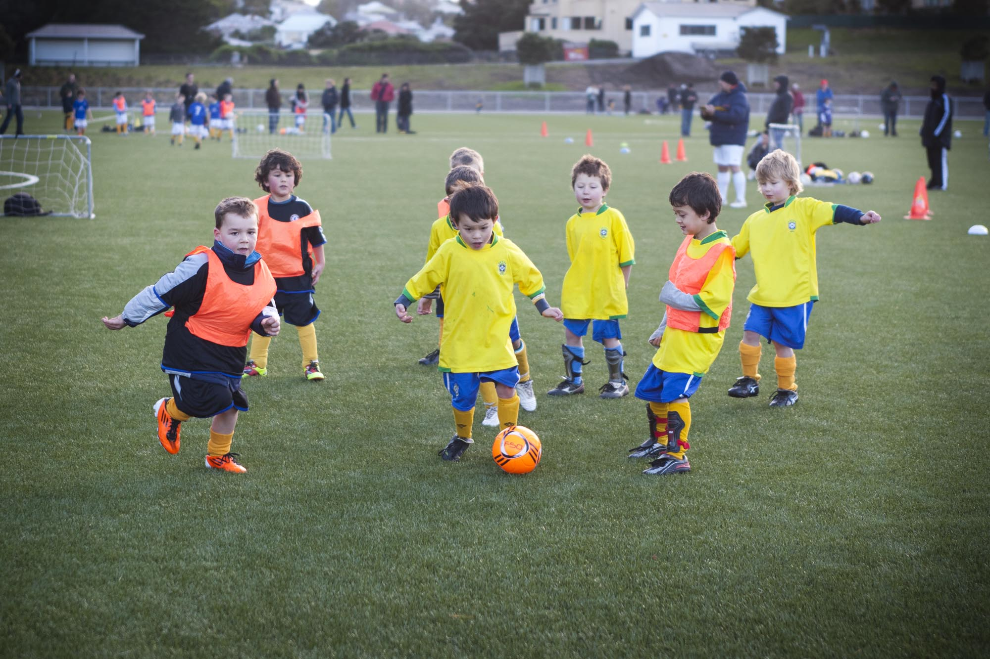

Slide 14
Impact opportunities
Ensure your community impact stories are being heard
Base your decisions on the best possible information
Reflect on why you exist and what you are seeking to achieve
Ensure funding is accessible to those that you are targeting
Align funding to outcomes

Slide 15
Alignment to outcomes
What story are you currently able to tell?
People engage more around why you exist than what you do
How do you know you are impacting lives? You are, but where’s the evidence?
Think about your stakeholders
National/Local Government is more interested in what impact your funding has had, rather than simply knowing you have distributed it
Is getting the evidence that difficult?
Applicants could be asked justify alignment to a set of outcomes
NPC’s could use alignment of the outcomes to assess for merit

Slide 16
Outcome options
Community
TLA annual plans or 10 year plans
Sector Specific
Strategic plans
Eg Sport NZ
Building a world leading system
Government
Reducing long-term welfare dependence
Supporting vulnerable children
Boosting skills and employment
Reducing crime
Think about the increased power of the class 4 gaming story for the upcoming review, or when a Council is next considering its ‘sinking lid’ policy if you could demonstrate you have contributed to any of the above outcomes

Slide 17
How can sport help you?
Anything to advise as a fellow investor?
Trusted relationships
Knowledge
Transparency
Key assistance:
Build stronger relationships for better mutual understanding
Provide you with better information
Annual priorities for sport
Regional priorities for sport
Gaps in sport funding
Trends and issues within sport

Slide 18
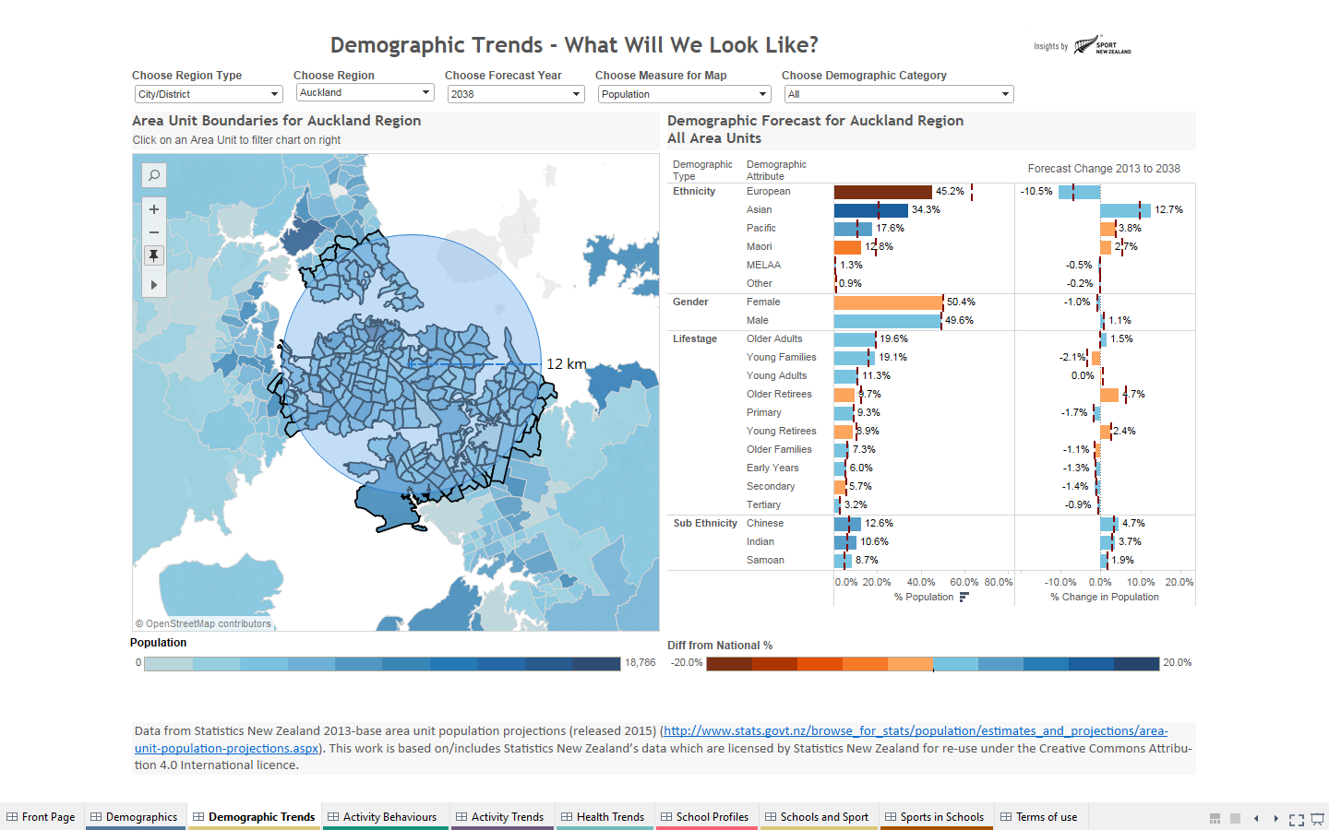

Slide 19
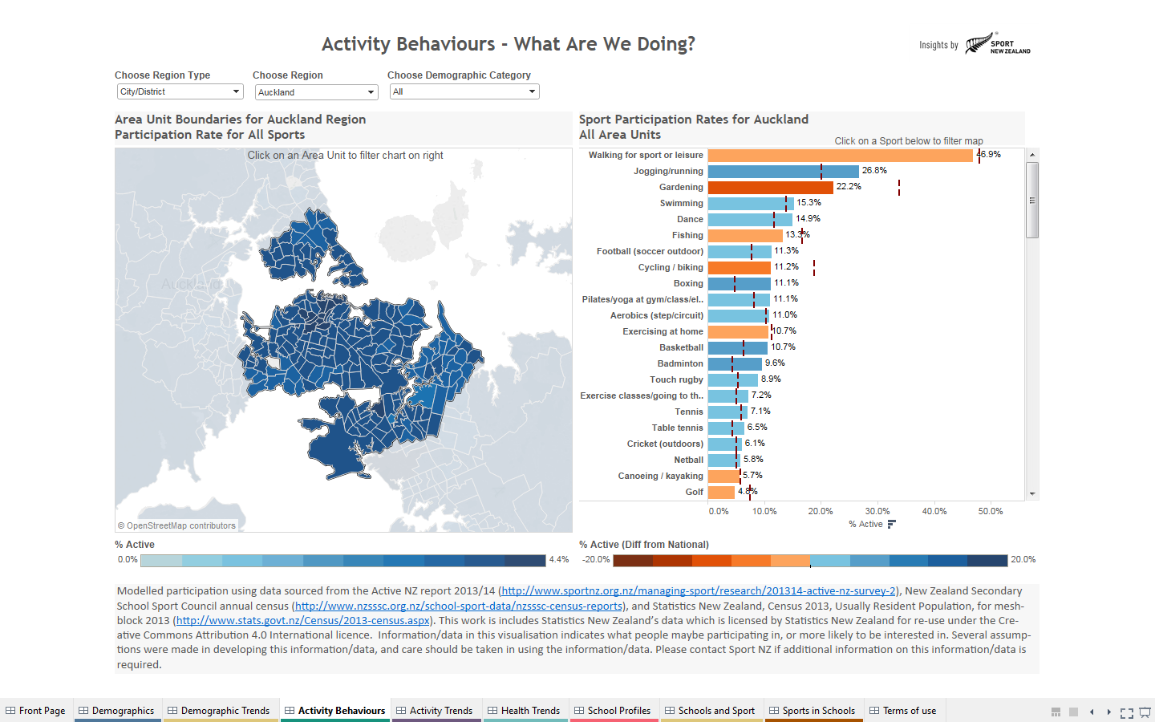

Slide 20
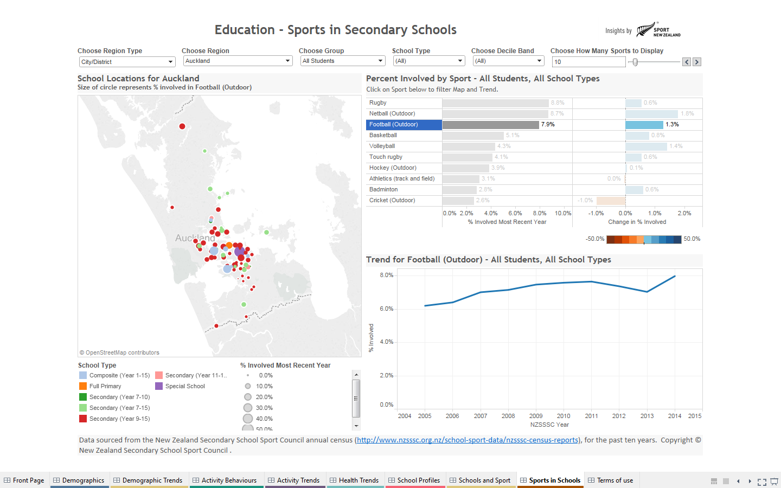

Slide 21
3.88 million New Zealanders are classified as living in urban areas, accounting for 86% of the total population.
Auckland has the highest population density and it is forecast to increase – 4,600 to ~13,300 people/sq km by 2031.
Auckland is the only region forecast to increase in relative population size to 2031 - ~2 million people.
Physical activity in secondary school students who live in urban areas is lower.
Urban children are less likely to participate in a school sports team.
There is more pressure for urban centres to adapt to changing ethnic diversity.
Urbanisation nationally is occurring faster than population growth.
Urbanisation is a significant national trend that impacts physical activity of different age groups differently.
Auckland is significant in the urbanisation of New Zealand.

Slide 22
The ethnic make up of New Zealand is changing, and this will require the New Zealand sporting system to adapt.
Asian ethnicities are growing faster than other ethnic groups. Chinese, Indian and Samoan ethnicities dominate broader Asian and Pacifica groups.
By 2021 Asian, Pacifica and Maori will represent over 50% of Auckland's population.
The median personal income of Asians is lower than that of Maori and only slightly above that of Pacific peoples.
27% of Pacific children were obese.
Ethnic diversity is increasing predominantly in urban environments.
Asian ethnicity participation is lower.
New residents 20-40 years old have no experience of childhood physical activity in the New Zealand context.
European
70 people
Maori
14
Middle Eastern/
Latin America/
African
1
Other
2
Asian
11
Pacifica
7
The Community Sport system needs to recognise that the ethnic composition of New Zealand is changing, and that the needs of ethnic groups are different.

Slide 23
How can sport help you?
Help you to tell your story and encourage the sport sector to do like-wise
Assist with your connections with the sector and into Government
Create forums and environments where sport priorities and approaches can be discussed
Assist with educating applicants
Be accessible to answer questions, address Boards etc

Slide 24
Possible topics for discussion
How do you encourage recipients and beneficiaries of your funding to tell the impact story?
Would your funding decisions benefit from improved information? What information would be most useful?
Do you agree that alignment of funding decisions to outcomes would assist you to demonstrate impact? How could this be best achieved?

Slide 26
To be the World’s most successful sporting Nation, we need a . . .
That is. . .

Slide 27
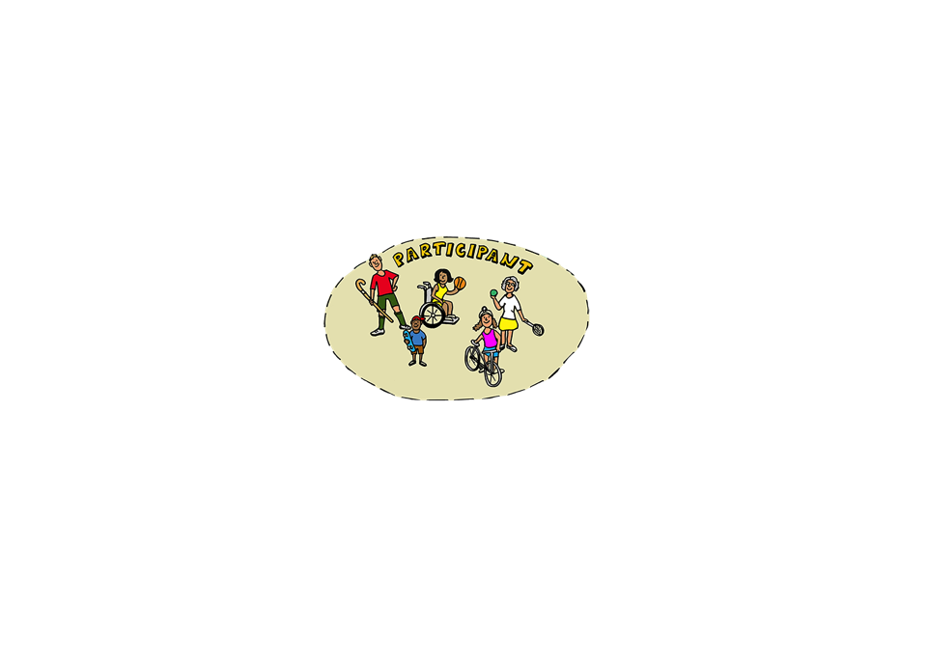
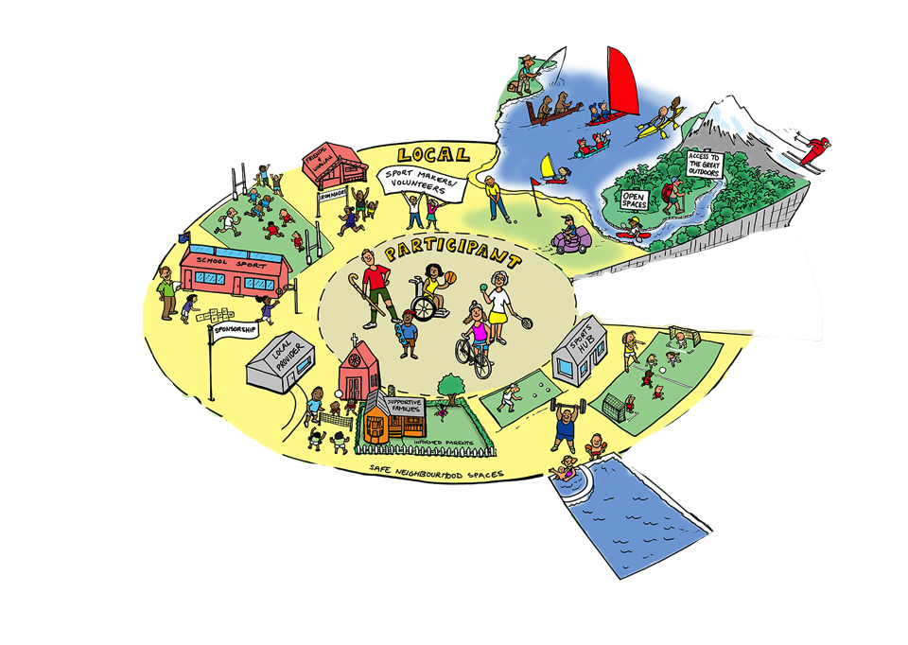
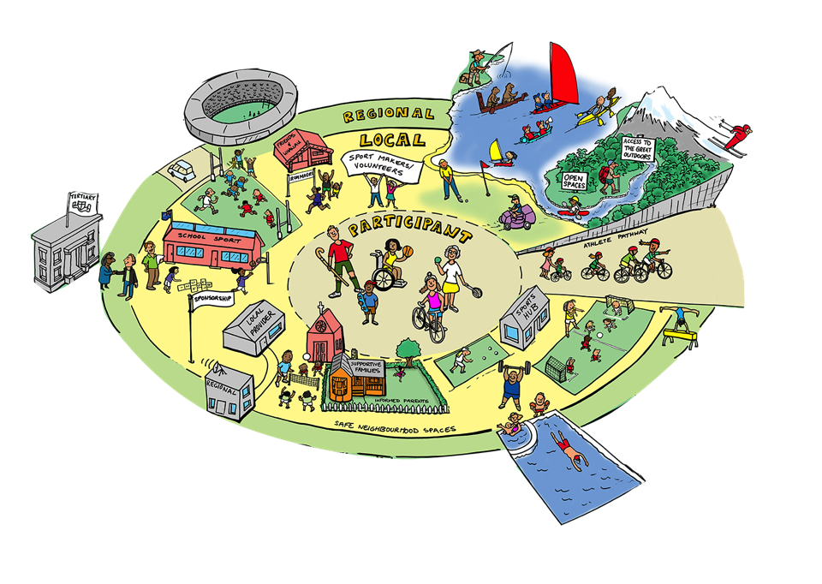
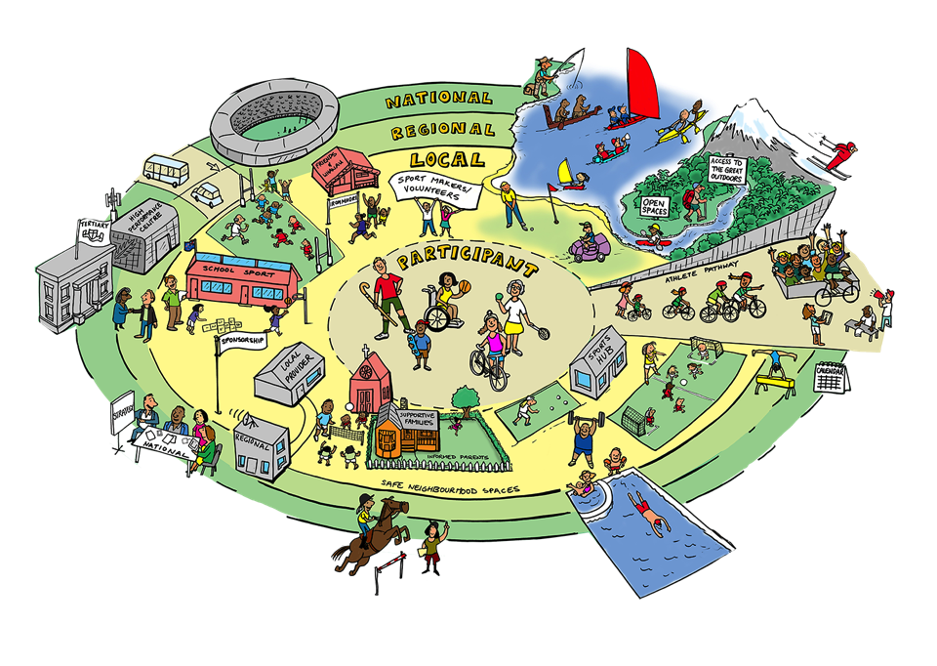
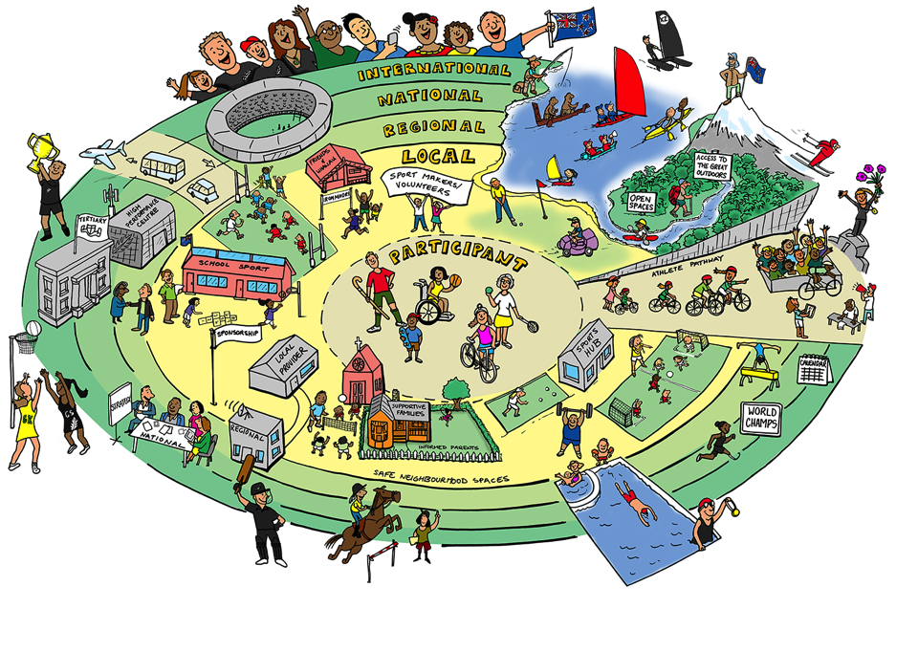

Slide 28
